Slide 1
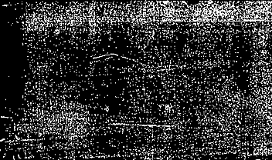
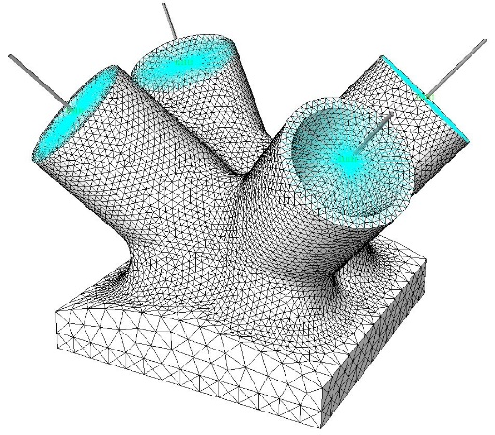
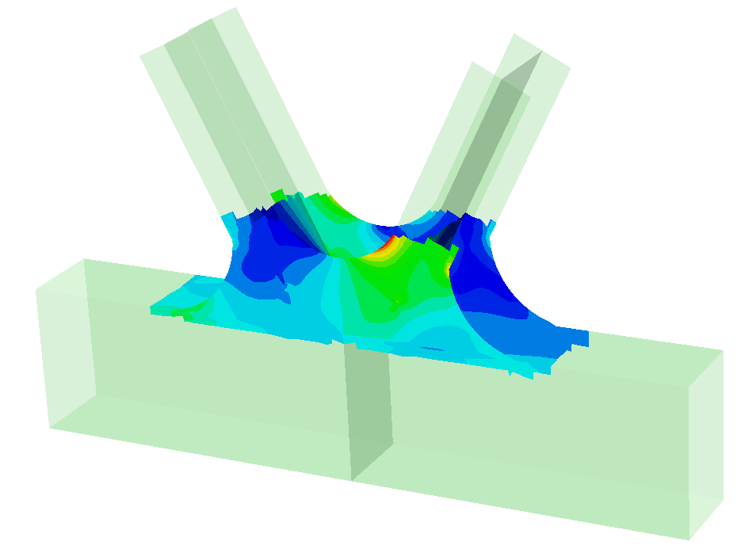
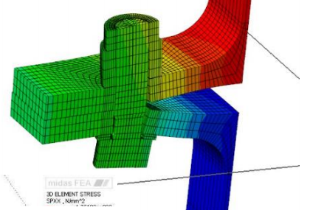
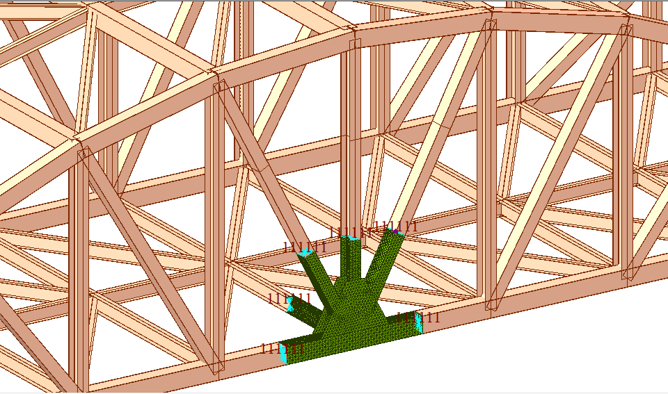

Joint Analysis of Truss Bridges
Vishal Jagad
Technical Support Engineer
Midas IT

Slide 2
Contents
Introduction - Features and Application of FEA NX
Detailed Analysis of Joint in FEA NX
Notes:
IN TODAY’S WEBINAR, First, we will discuss various features and applications of midas fea NX pertaining to the modelling and design of steel bridges. Then we will consider an example of Steel Arch bridge and will cover everything from modelling to design. In the later part of the presentation, the detailed analysis of a Steel joint in FEA NX will be considered.
Lets briefly discuss the features offered by midas civil…

Slide 3
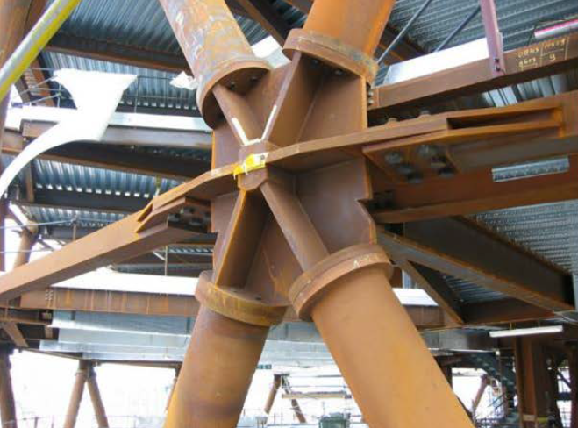
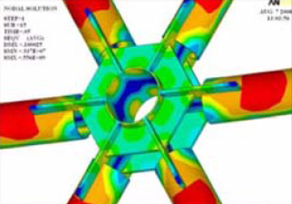
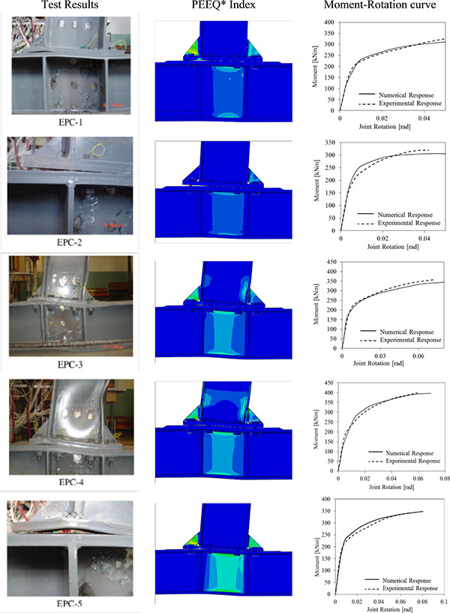
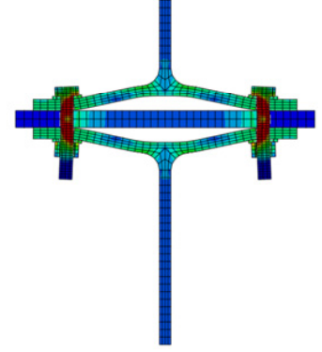
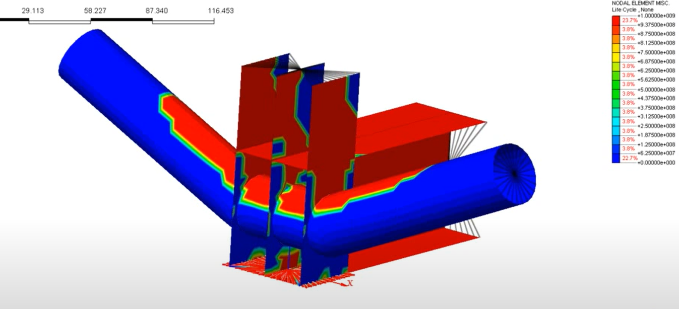
Introduction - Applications
Joint systems with complex stress distribution
Prying action and contact force
Fatigue Analysis of Truss Joint
Notes:
Again we have a Joint connection here which is part of a global model that has several incoming members at a node. This results in a complex stress distribution that cannot be predicted by analytical formulations or a global model of the structure. Therefore, an analytical study in FEM software is necessary to optimize the plate shapes and sizes based on strength, cost and buckling capacity.
To predict prying forces for typical bolted connection there are several codal provisions but to accurately determine stress in the plates and bolts for generalized connections FEM based simulation is required.

Slide 4
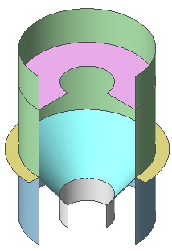

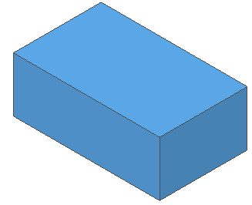
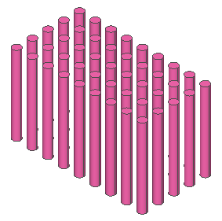
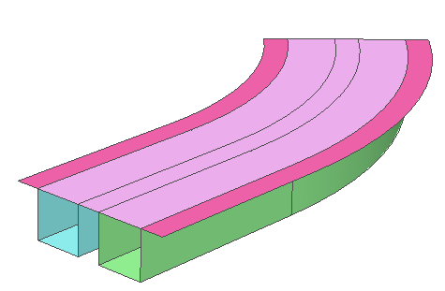
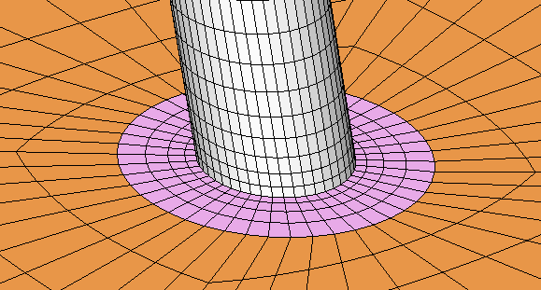
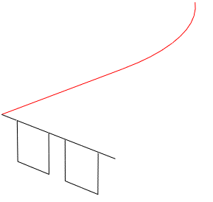
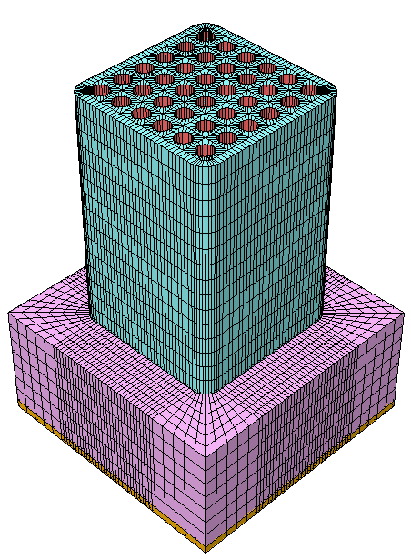
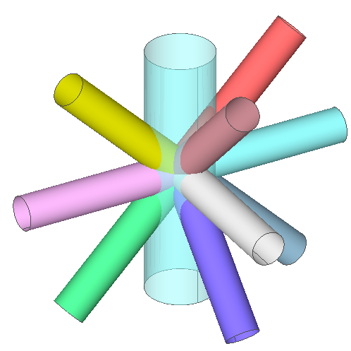
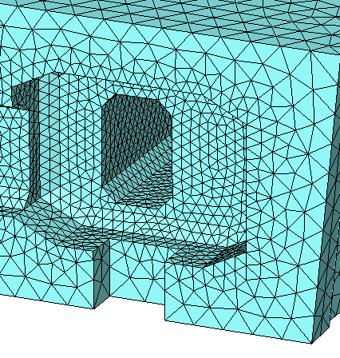
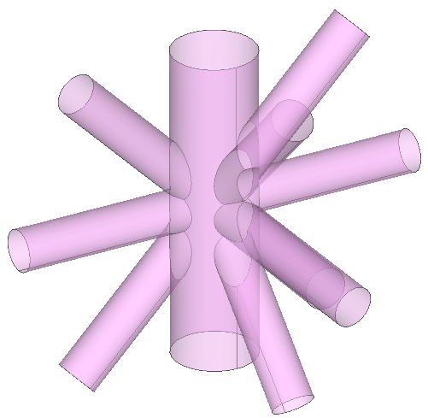
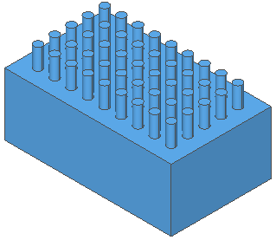
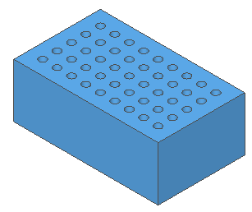
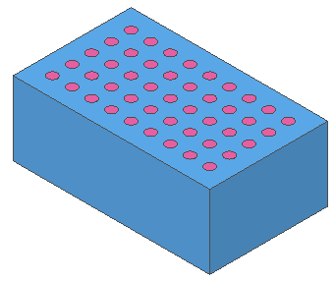
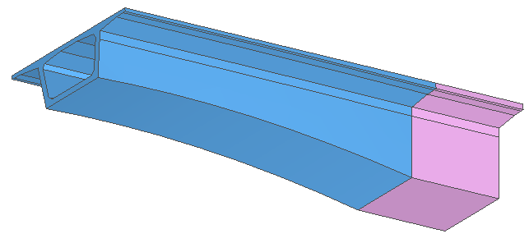
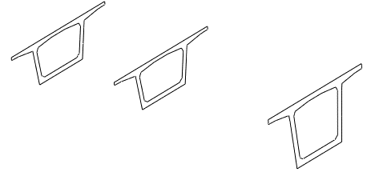
Introduction - Features
Revolve
Profile
Midas FEA NX
A
B
+
Guide Curve
Sweep
Profiles
Trim Surfaces
Loft
Extrude
Loft
Fuse
(A ∪ B)
Cut
(A - B)
Embed
(A - B) + (A ∩ B)
Profiles
Adaptive seeding and precise mesh control
Boolean operators
CAD based Modeling tools
Notes:
Advanced meshing tools of FEA NX allows mesh control along the different edges from fine to coarse
As explained the Boolean tools can be used to fuse, cut embed solids
The CAD based tools can be used quickly to generate the complex geometries
Lets look at the post processing results of FEA NX…

Slide 5
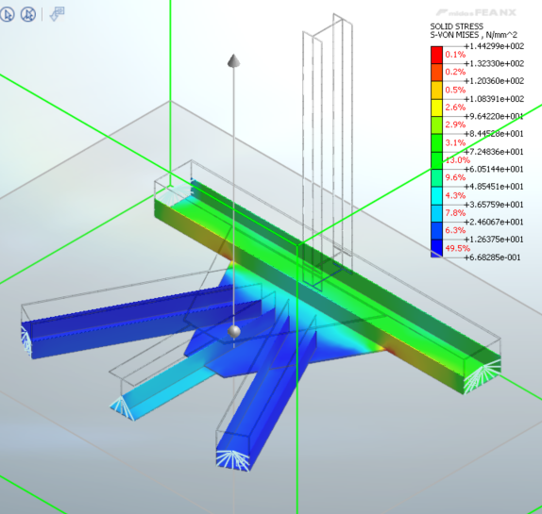
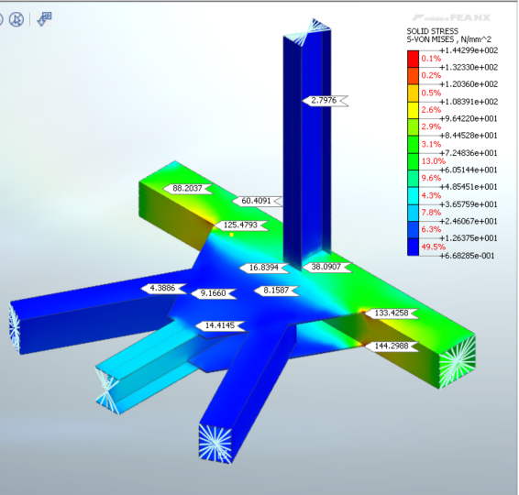
Introduction - Features
Midas FEA NX
Stress Contour – Clipping Plane tool
Stress Check – Probe
Fatigue Analysis – Damage, Life cycle
Notes:
The midas FEA NX gives uniform contours for stresses and deformations throughout the solids. The clipping tool can be used to check the stresses inside the solid at a given section, probe tool can be used to extract results at a given node of the solid, and Fatigue Analysis can be used to determine damage and Life cycle of the element based on codal provisions

Slide 6
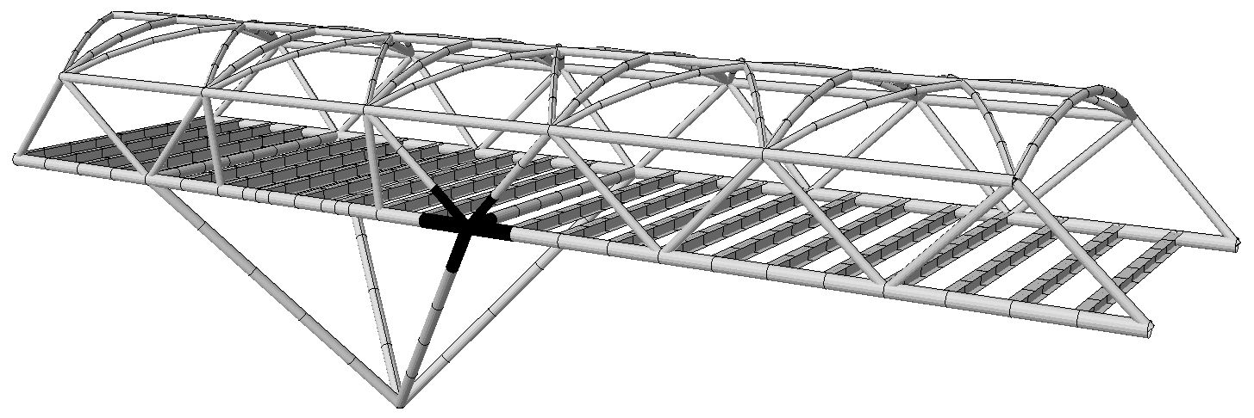
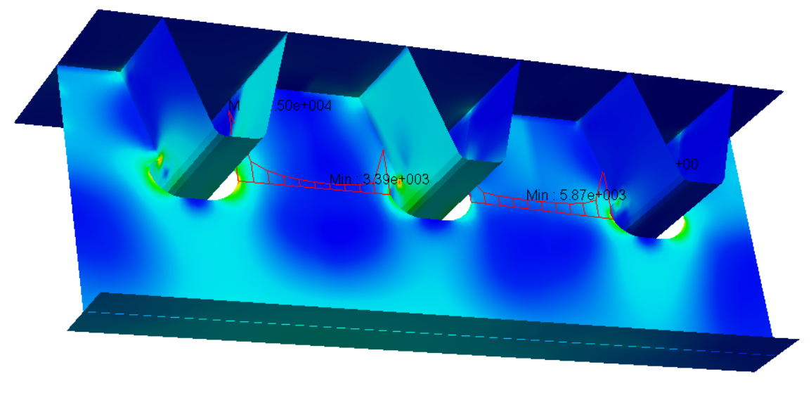
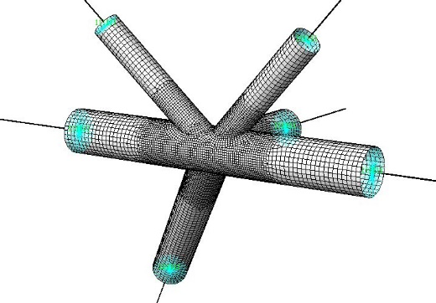
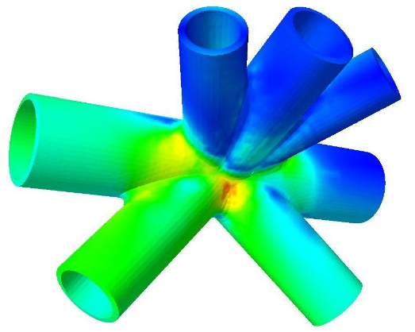
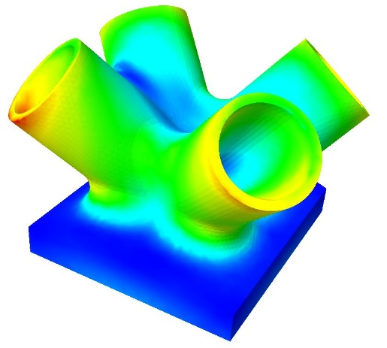
Introduction - Applications
Orthotropic Deck Modeling
Detailed FE models of connections using solid elements
Notes:
Here are a few of the applications of Civil and FEA NX,
this is an example of a steel footbridge modeled, analysed & designed in midas Civil. Here, the frame elements are used to create the different members of the bridge. In this image, we can see several members are getting connected at a node. The global model created in civil will allow us to design the individual members but the local stresses generated at the joints cannot be determined from the civil model. Hence, it is essential to design the joints using Finite element model and determine the local stresses at the joint location so that steps can be taken to ensure the stresses are within permissible limits. The joint is modeled using FEA NX in this case.
Similarly, in orthotropic decks there are cutouts and corrugations in the deck elements which results in the local stress concentration at those locations. Such applications require FEM-based modeling to determine the local stresses distribution, plate buckling and plastic strain distribution.
Further, for advanced applications such as fatigue analysis of the connections to determine life cycle and damage FEM based modeling is required.
All this can be achieved using midas FEA NX.
Let us move ahead with the example model of steel Arch bridge to understand the interoperability of midas civil and midas fea nx..

Slide 7
Steel Arch Bridge
Global Model with frame elements
Detail Model with shell/solid elements
Member Design/ Section Optimization
Global Linear/ Nonlinear Analysis
Fatigue Analysis
Local Linear/ Nonlinear Analysis
Civil NX
FEA NX
Moving load / Buckling Analysis
Local Stress Check
Notes:
These are the steps involved in modeling, analysis, and design of steel arch bridge:
Global model of the bridge using frame elements is created in midas civil, here material , sections, loads, and boundary conditions are applied. Global linear, nonlinear or buckling analysis is performed for the structure in midas civil. Further, moving load analysis, response spectrum analysis are performed on the structure and the results are obtained for each load case.
After that, the design checks for the members are performed for strength and serviceability load case as per the code available in the design tool of midas civil. Here, the sections can be optimized using steel design tool of midas civil.
Once the member design is completed as per the global model. The next step is to model joint in FEA NX with required boundary conditions and loads or displacements as per the global model. Now, local linear, nonlinear, and buckling analyses are performed and the element is checked for local stresses, buckling, and plastic strains.
Further, advanced analysis such as Fatigue analysis can be performed if required.

Slide 8
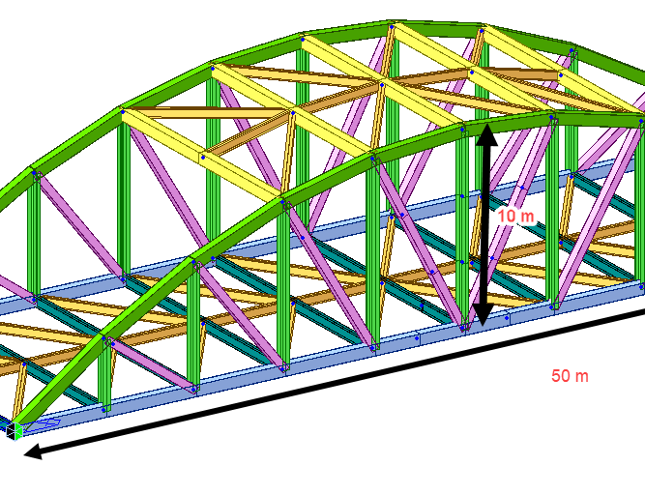

Steel Arch Bridge
Span: 50 m
Deck Width: 14 m
Max height of Arch: 10 m
Components: Main Girder, Bracing, Strut, Diagonals, Vertical
Simply supported

Slide 9
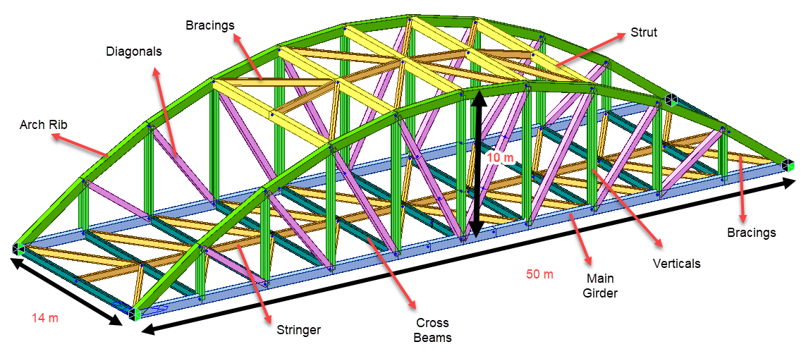
Steel Arch Bridge – Midas Civil NX
Demonstration

Slide 10
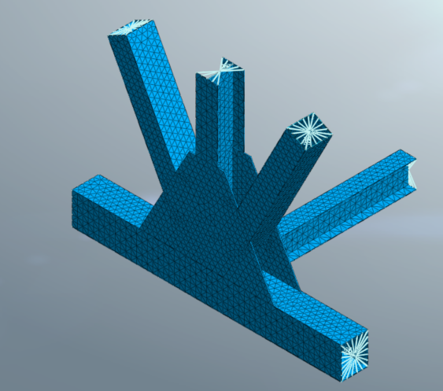
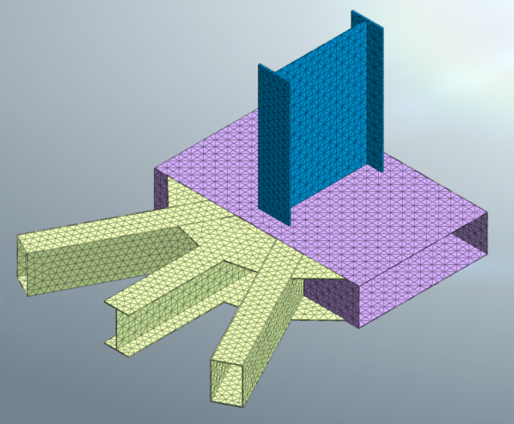
Joint Modelling & Analysis – FEA NX
Demonstration
Solid Modelling of Steel Joint in FEA NX

Slide 11
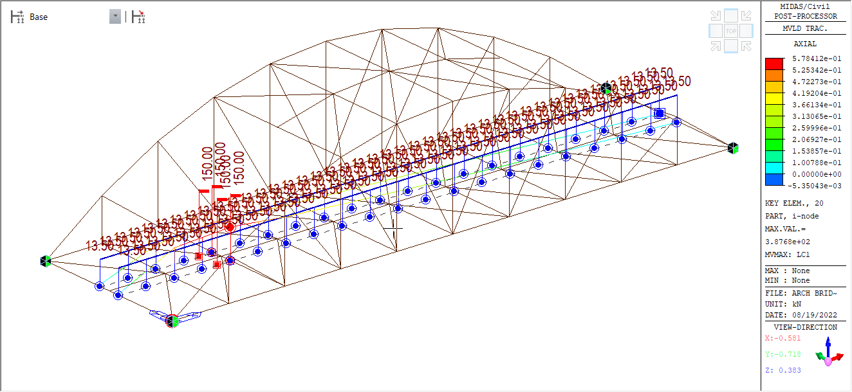
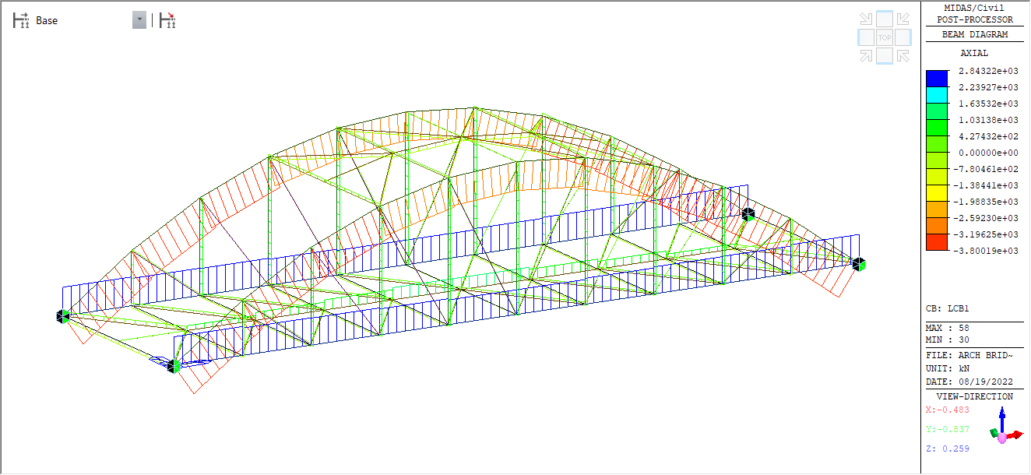
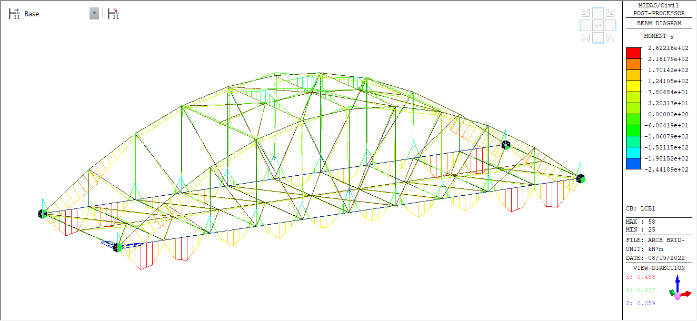
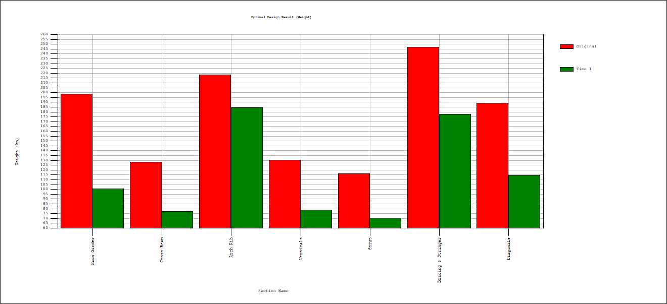
Steel Arch Bridge Design – Midas Civil NX
Results - Analysis & Design
Critical position for vehicular load
Axial Force and BMD in the members
Steel Design Optimization (Original Qty: Red, Updated Qty: Green)

Slide 12
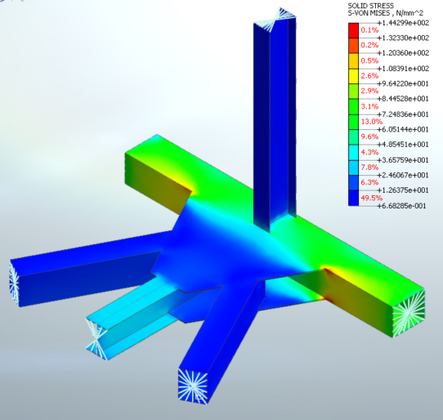
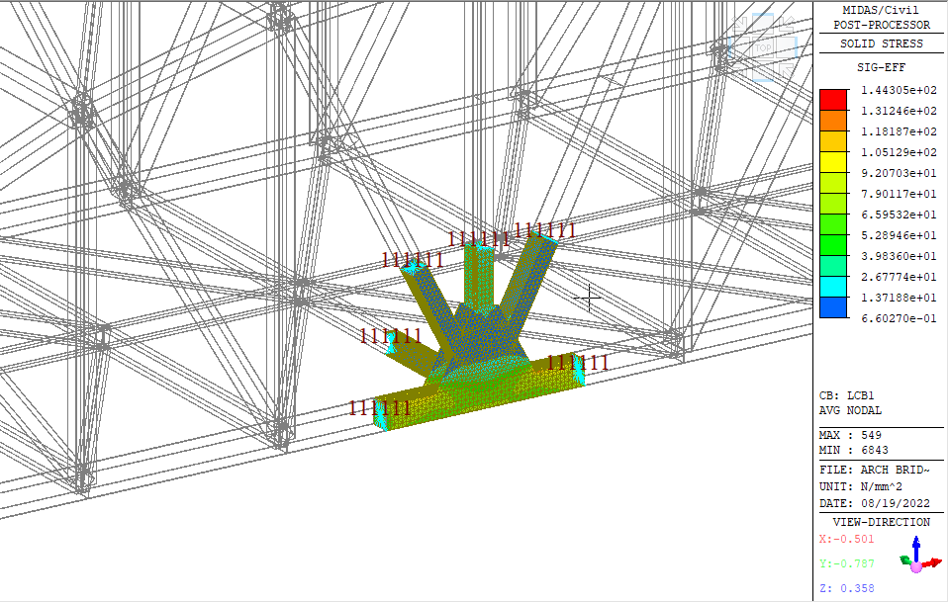
Joint Modelling and Analysis – FEA NX
Results - Analysis
Inserting solid FEA NX model into Civil Global Analysis
Detail Analysis of Steel Joint in FEA NX

Slide 13

THANK YOU!
Notes:
I hope this session might have given you a fair idea about the capabilities of midas civil and FEA NX. And how the combination of the two can be used effectively

