Slide 1
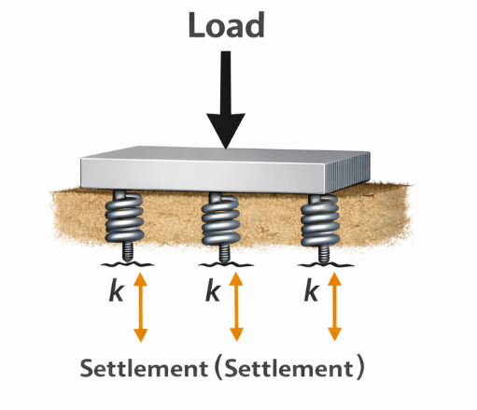

Soil Structure Interaction Basics for Foundation Engineering
- Types of SSI Methods
- Interaction between Midas Geotechnical and Structural Platforms
Harsha Tadavarthi, MIEAust
Technical Manager at MIDAS IT Australia

Slide 2
01.
Soil Structure Interaction
02.
Various SSI Methods
03.
Detailed Analysis using Soil Continuum Method
Interaction Between Midas Geotechnical and Structural Platforms
04.
05.
Advantages

Slide 3
Soil Structure Interaction (SSI)
What is it?
Applicability?

Slide 4
What is SSI ?
Interaction of Stiffness and Deformation between Structure and Soil
Necessary for Adequate Assessment of Stresses and Forces in the Supporting Structure
Why SSI ?
Supporting Soil,
Generates Loading and
Provides Resistance to Loading
Force on Deck and Pier depends on,
Location of the foundation
Flexibility of foundation
Supporting Soil Behaviour

Slide 5
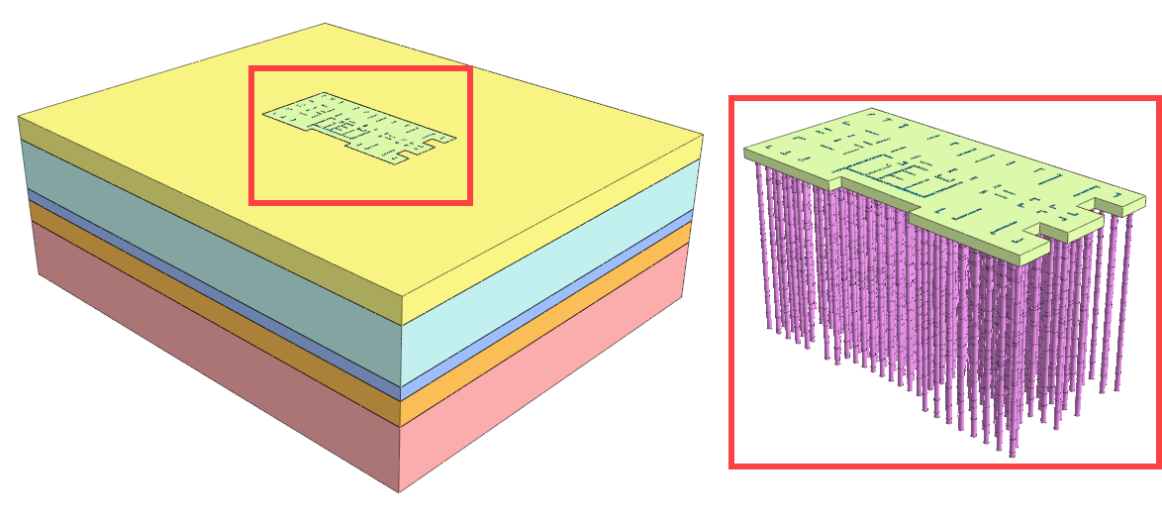
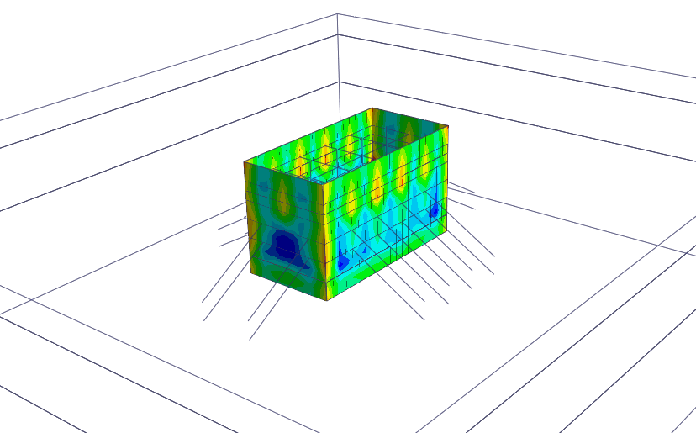
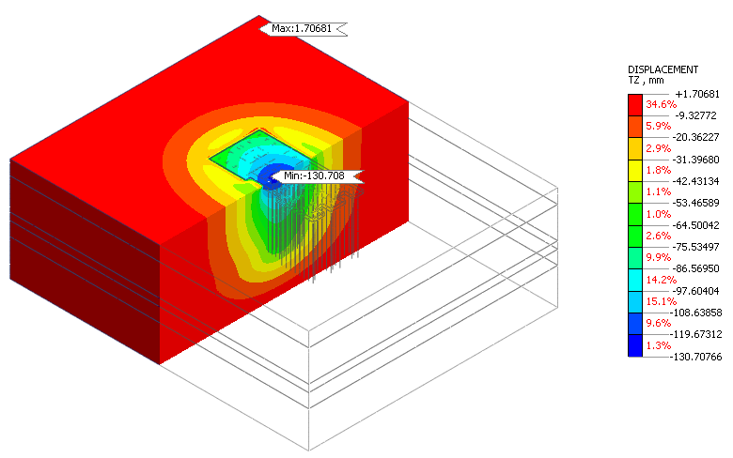
Applicability
Deep Excavation
Pile Raft Foundation

Slide 6
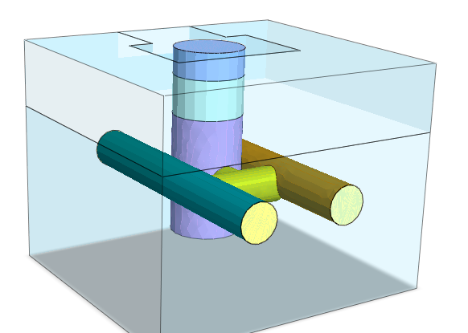
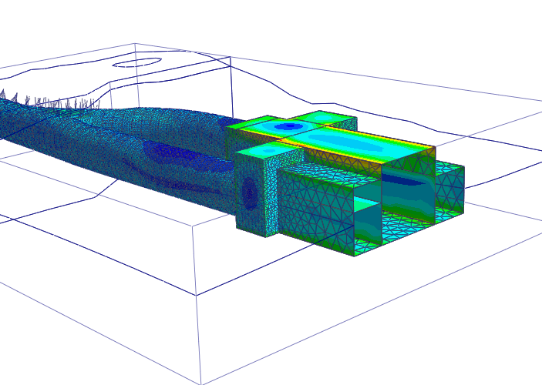
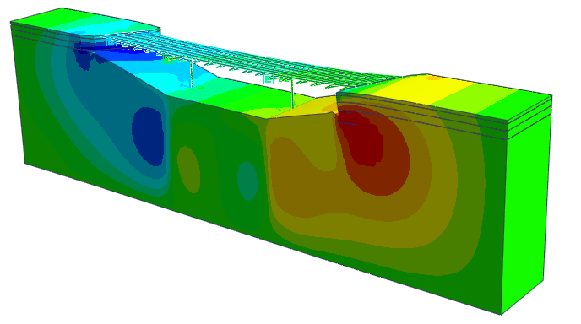
Shafts, Tunnels, Subway Structures, and Bridges
Applicability

Slide 7
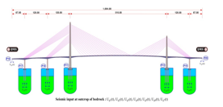
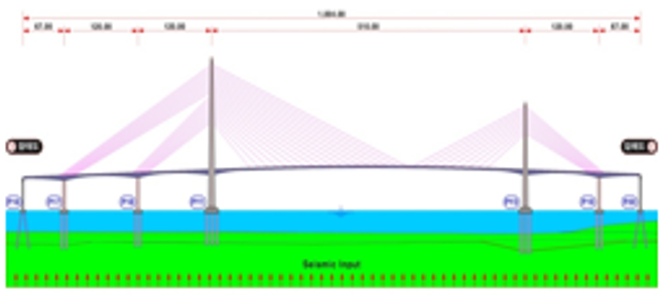
Broad Classification of SSI Methods
Substructure Method
Based on superposition of events, it separates the problem into two simpler parts.
1) Free Field Analysis: The reaction / response of the soil is determined
(mainly where the structure will be)
2) Structural Analysis: The soil can be modeled as spring damper system(impedance) with that response. The detailed structure is designed with the idealization of soil as independent damper spring
Eg: Wrinkler Springs, Springs from Empirical Equations etc
Direct Method
The soil-structure system is modeled and analyzed in one step directly
Get response with of both soil and structure simultaneously.
Numerical methods: Continuum Methods FEM, FDM

Slide 8
Substructure Method
Various SSI Methods
For Spring Stiffness Calculation

Slide 9
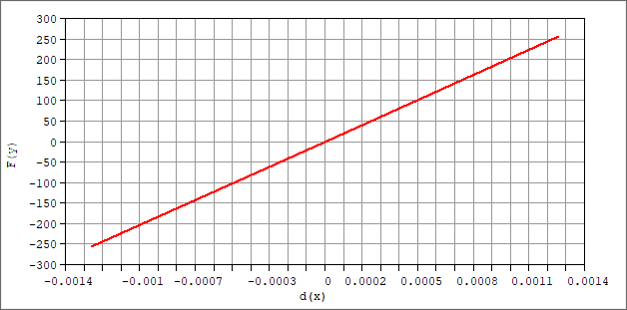

Linear Springs
Winkler Foundation Model
Bowles’ Method
Vesic Method
Poulos & Davis Elastic Solutions
Etc.,

Slide 10
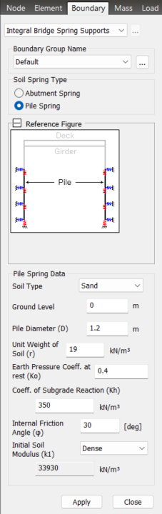
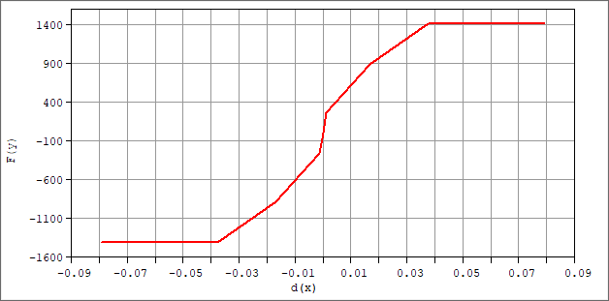
Multilinear/P-y/T-z/
Nonlinear Springs
Empirical Approach
B. M. Lehane Theory
Reese
Matlock
Bowles
Vesic
Janbu
Etc.,

Slide 11
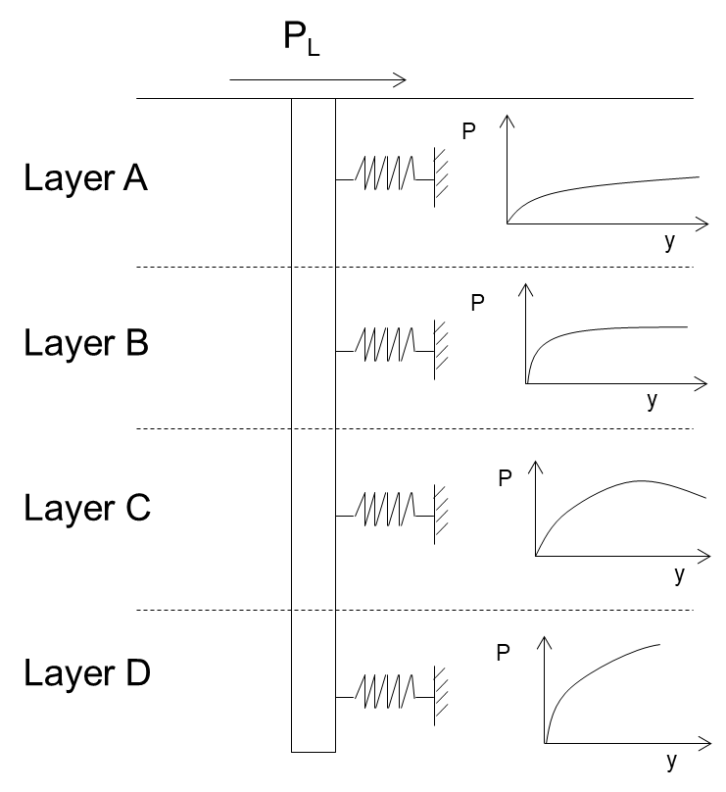
Multilinear/P-y/T-z/
Nonlinear Springs
Closed Form Elasticity
Boussinesq’s
Poulos & Davis
Randolph
Etc.,

Slide 12
Direct Method
Detailed Analysis using Soil Continuum Method
For Spring Stiffness Calculation

Slide 13
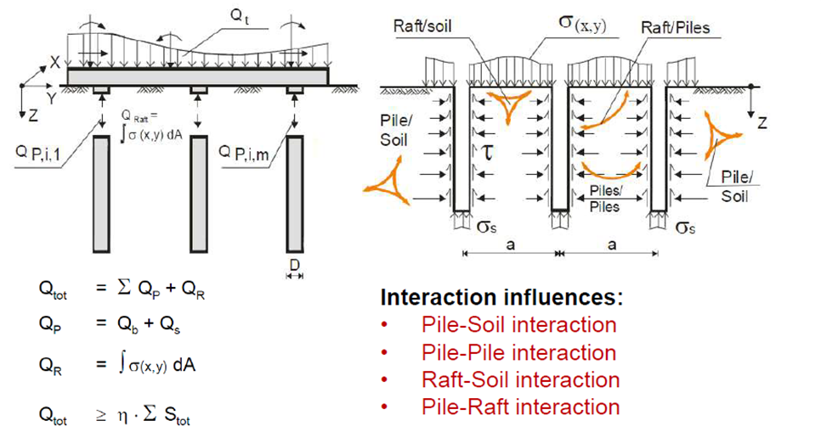

Soil Continuum Method

Slide 14
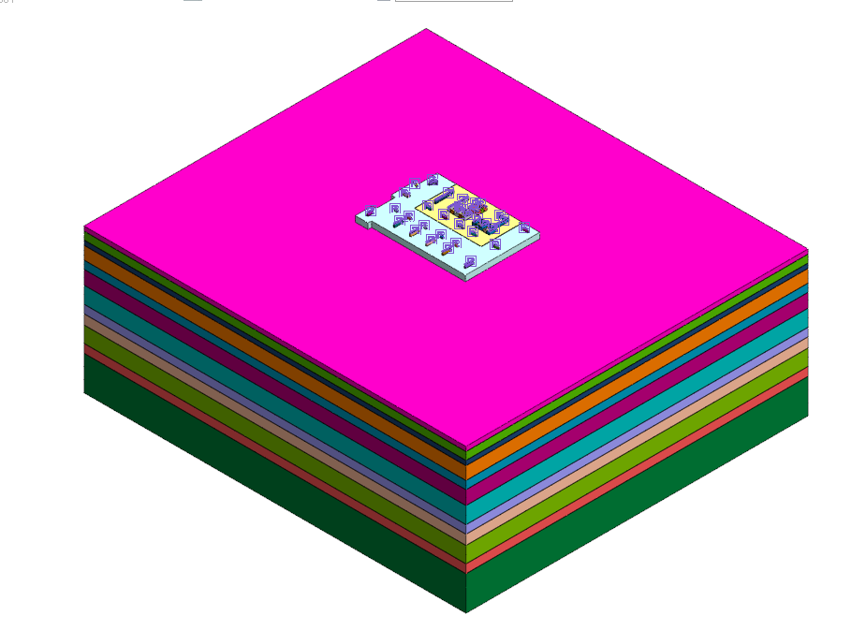
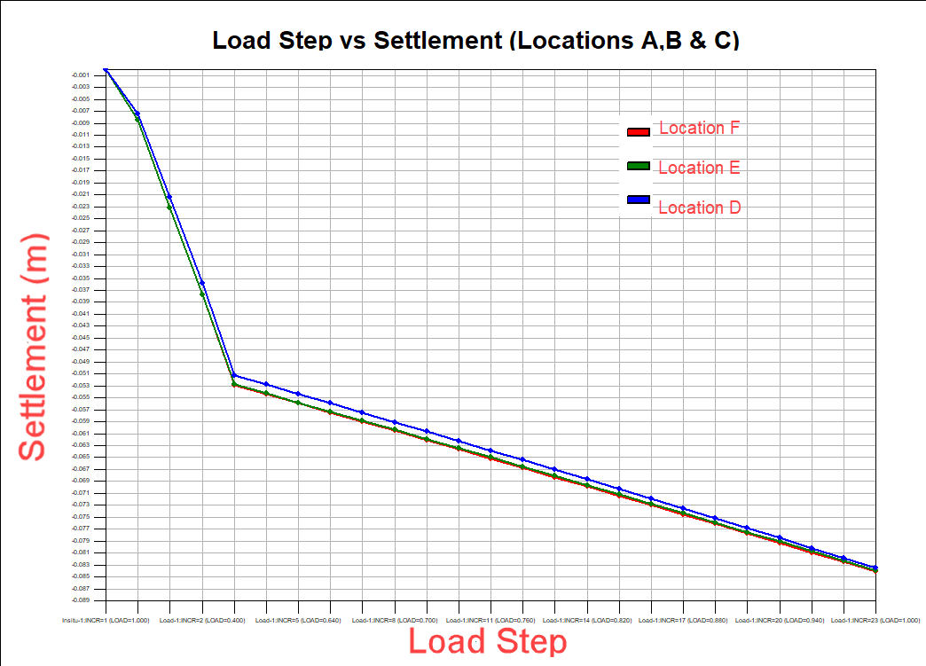
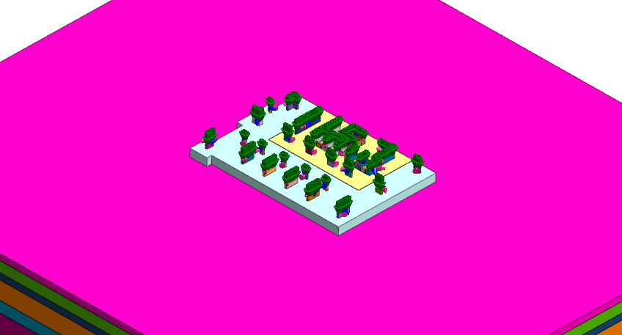
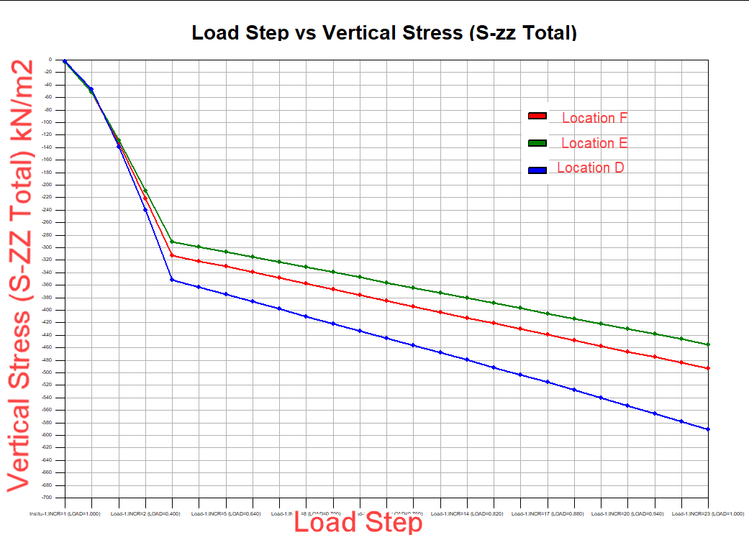
Step-1:
Foundation and Soil Modeling
Step-2:
Load Table Import/Export Option.
(Load imported into GTS NX via excel sheet from any Structural tool)
Step-3:
Export the Stiffnesses back to Structural tool

Slide 15
Soil Continuum Method - Advantages
Plastic Nature of Soil is considered
Pile Group Effect is considered
All Geotechnical/Geological features such as Topography, Strata, Faults etc can be considered.
Time Dependent Properties consideration for Concrete and Soil
This Method can be considered as a CHECK to assess the stability of the Building/Bridge with the above-mentioned effects considered
Also, this method can be helpful in DESIGN OPTIMIZATION as optimal Spring Data is calculated.
Multiple Analysis maybe required to be carried out with updated loads for design optimization.
Limitation: Lot of Output from Geotech Software and more time is needed for proper Interpretation and thereby Spring Stiffness Calculation. Data storage and transfer is challenging

Slide 16
Interaction Between Midas Geotechnical and Structural Platforms

Slide 17
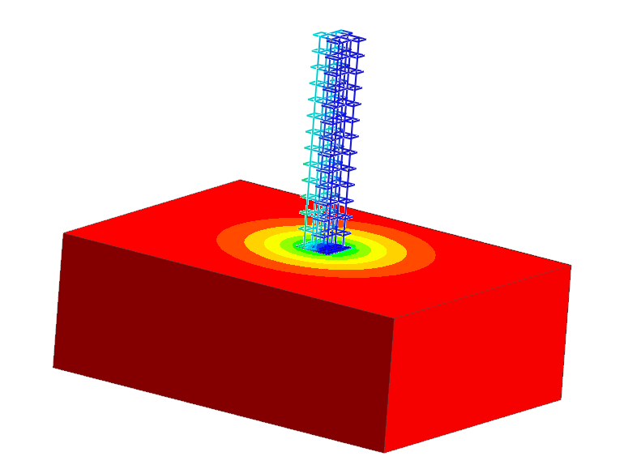
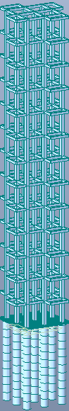


Soil Continuum Method using MIDAS Programs - For Spring Stiffness
Reactions
Structural
FEM Model
Structure Modeled
along with Soil
Force-Displacement Curves
One full ITERATION – Transfer of Loads and springs between Geotech and structure engineers

Slide 18
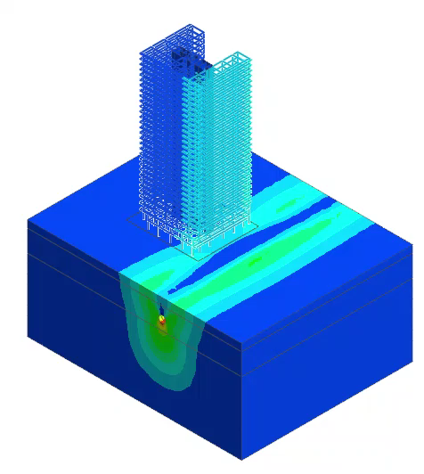
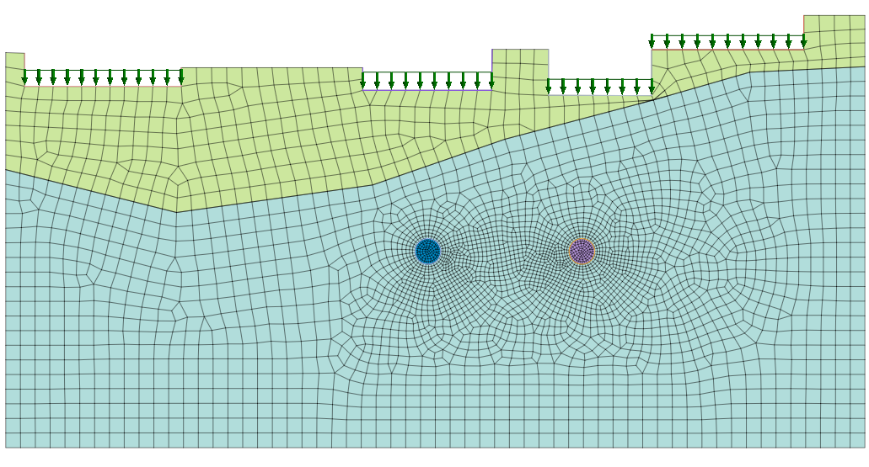
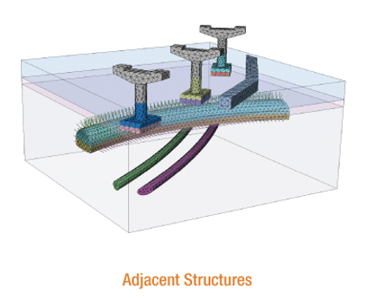
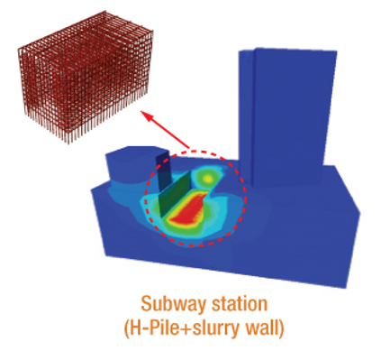
Interaction b/w MIDAS Programs – Other Applications
Effect of Groundworks on adjacent Structures and Vice Versa.
The building along with foundation is considered.
Hence Differential Displacement can be easily estimated which in real results in cracks in the building.
Only load from the buildings is Considered
Note that, modelling time is significantly reduced as now only ground needs to be modelled after importing the Structure.

Slide 19
Soil Continuum Method - Advantages
Plastic Nature of Soil is considered
Pile Group Effect is considered
All Geotechnical/Geological features such as Topography, Strata, Faults etc can be considered.
Time Dependent Properties consideration for Concrete and Soil
This Method can be considered as a CHECK to assess the stability of the Building/Bridge with the above-mentioned effects considered
Also, this method can be helpful in DESIGN OPTIMIZATION as optimal Spring Data is calculated.
Multiple Analysis (iterations) maybe required to be carried out with updated loads for design optimization.

Slide 20
Interaction between Midas Programs- Advantages
Plastic Nature of Soil is considered
Pile Group Effect is considered
All Geotechnical/Geological features such as Topography, Strata, Faults etc can be considered.
Time Dependent Properties consideration for Concrete and Soil
This Method can be considered as a CHECK to assess the stability of the Building/Bridge with the above-mentioned effects considered
Also, this method can be helpful in DESIGN OPTIMIZATION as optimal Spring Data is calculated.
Multiple Analysis maybe required to be carried out with updated loads for design optimization.
Defining required Interaction between Structure elements and Soil Continuum such as Interface – Tension Cut Off, Slip, Crack etc.,
Efficient data transfer between Geotech and Structure Teams as Geotech and structure software talk to each other directly.
Direct Spring or Force or Displacement transfer from Geotech to Structure software.
Highly helpful for Critical Structures like Integral Bridge.
Significant reduction is modelling time as the structure is imported.
Additional Benefits

Slide 21
NX Interact
Fully Automated Data Transfer via API for Iterative SSI Analysis among MIDAS Programs

Slide 22
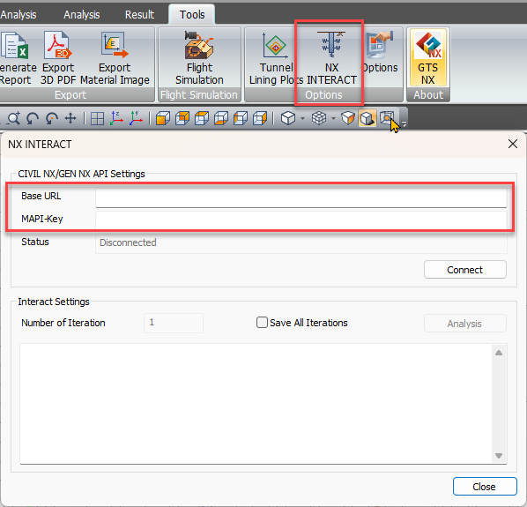
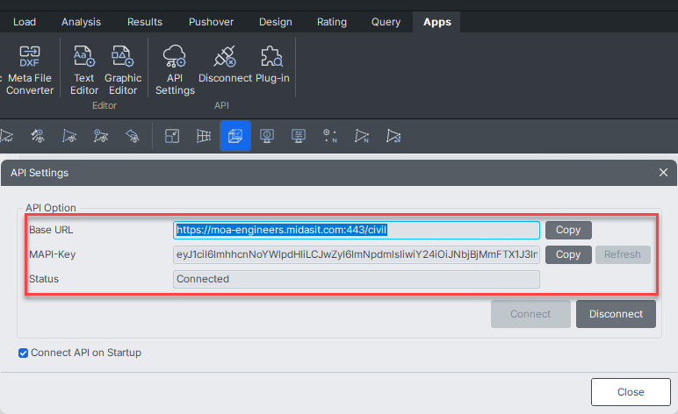
NX Interact function Automates the Iterative SSI analysis and data transfer between GTS NX and CIVIL NX/GEN NX via API.
We can input number of iterations Eg: 5,10..

Slide 23
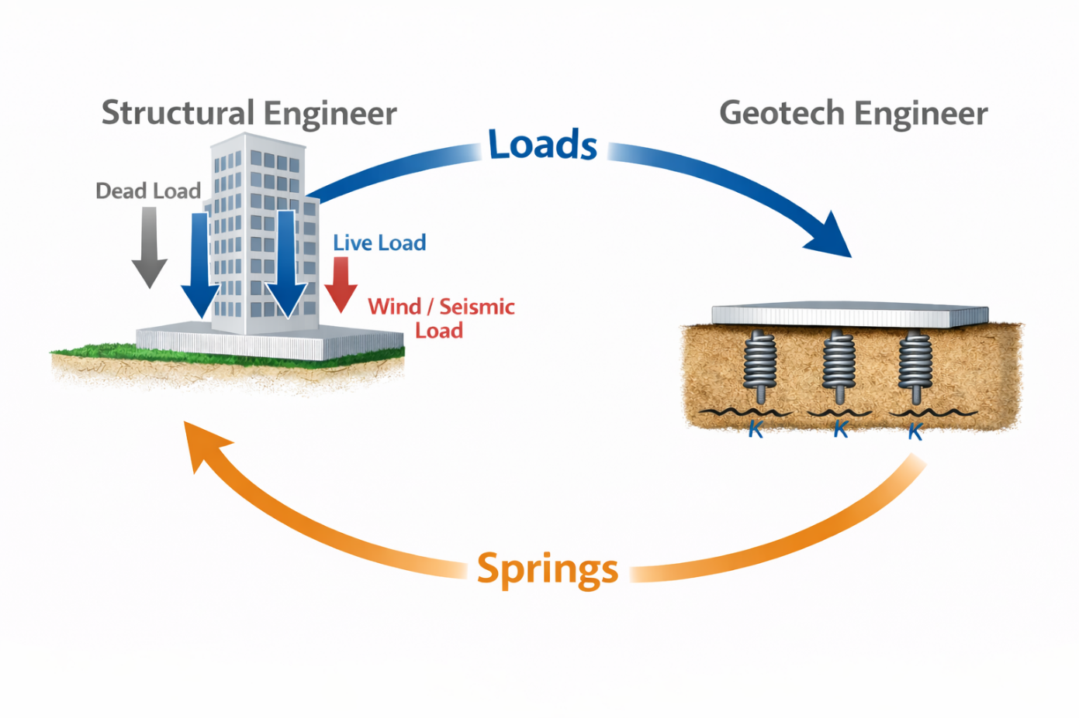
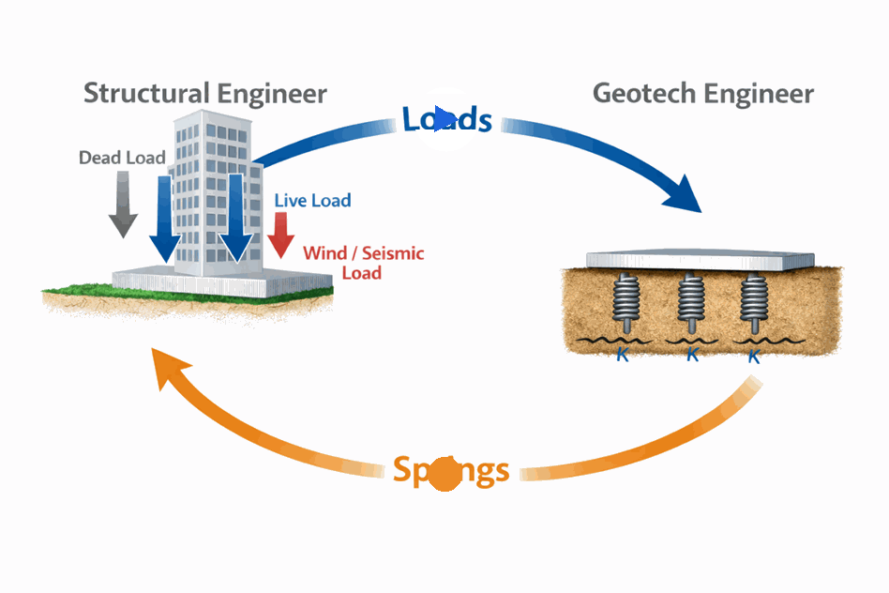
With
NX Interact

Slide 24
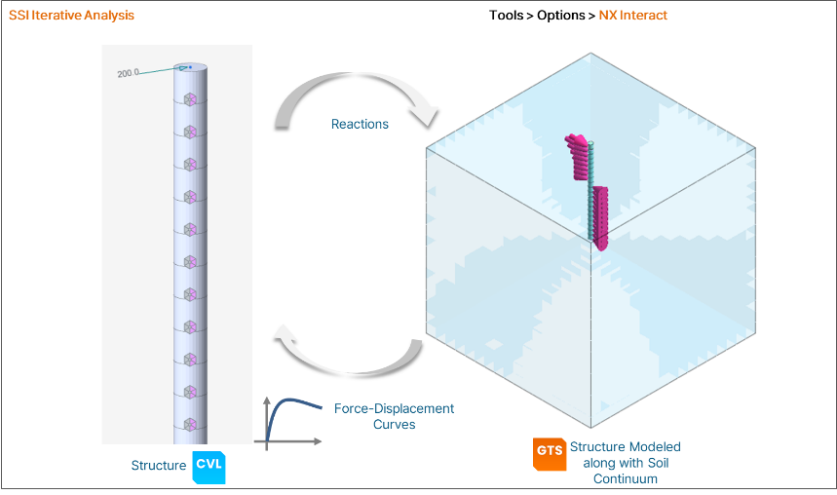
Example:

Slide 25
Thank You!!

