Slide 1
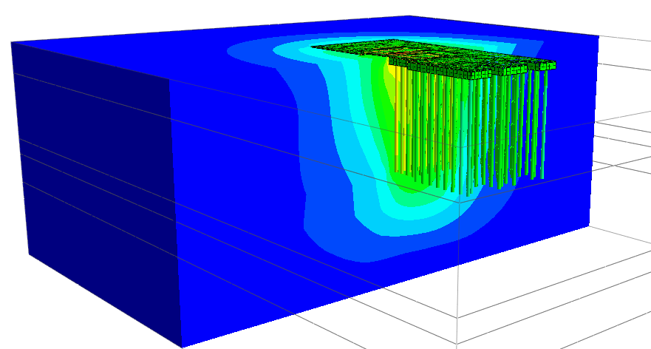

Soil Structure Interaction in the case of Pile Raft Foundation
- NX Interact Function for Laterally Loaded Single Pile
- Demonstration on Pile Raft Foundation and Results Extraction
Harsha Tadavarthi, MIEAust
Technical Manager at MIDAS IT Australia

Slide 2
01.
NX Interact Function
02.
SSI Iterative Analysis of Laterally Loaded Pile using NX Interact
03.
Detailed Analysis using Soil Continuum Method
Pile Raft Foundation using Soil Continuum Method
04.
05.
Results Extraction

Slide 3
NX Interact Function
Fully Automated Data Transfer via API for Iterative SSI Analysis among MIDAS Programs

Slide 4
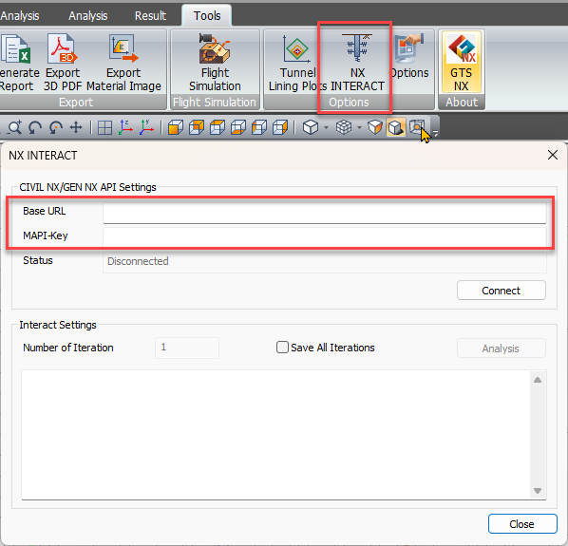
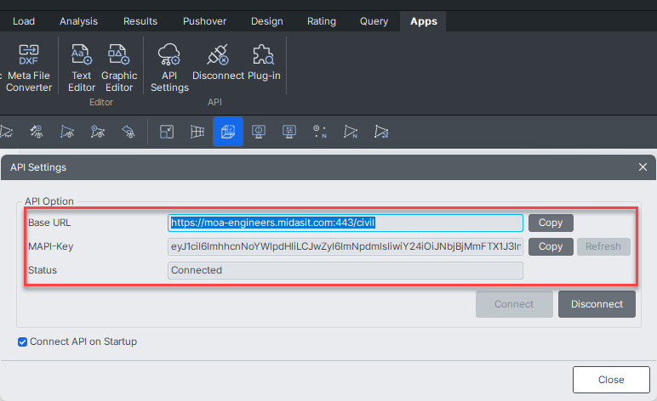
NX Interact function Automates the Iterative SSI analysis and data transfer between GTS NX and CIVIL NX/GEN NX via API.
We can input number of iterations Eg: 5,10..

Slide 5
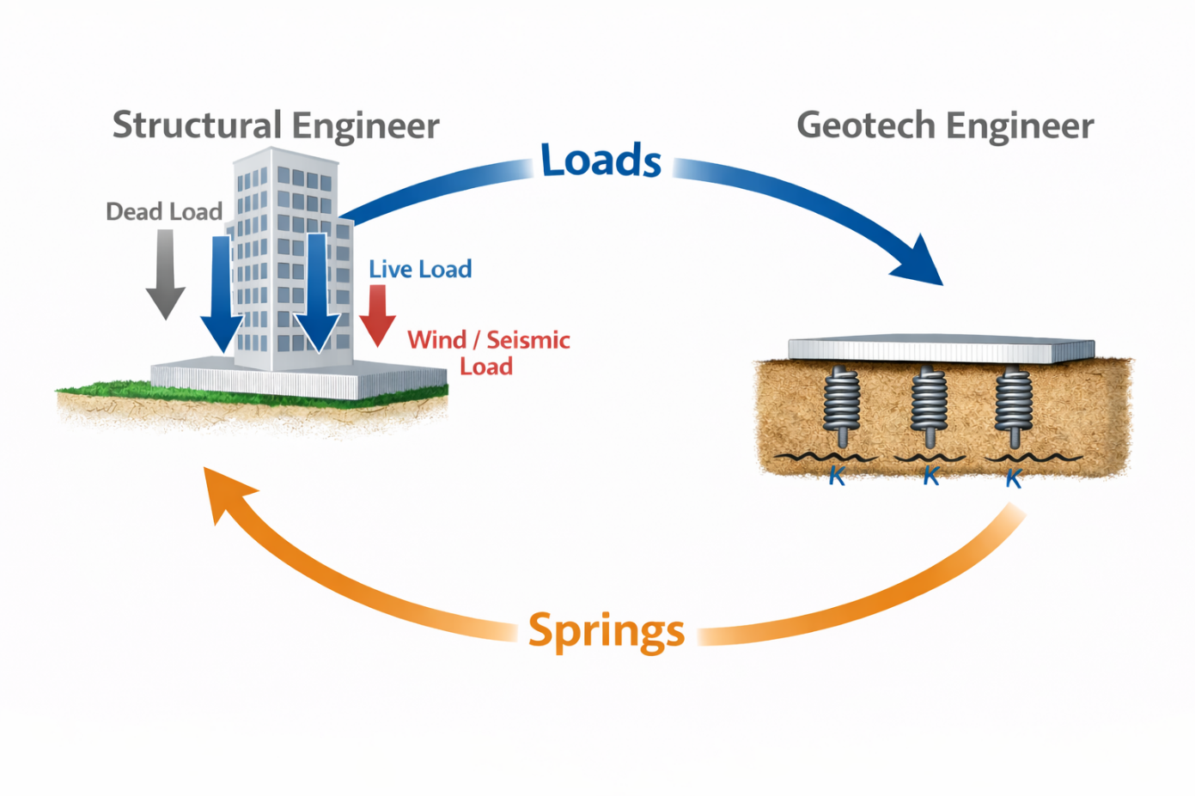
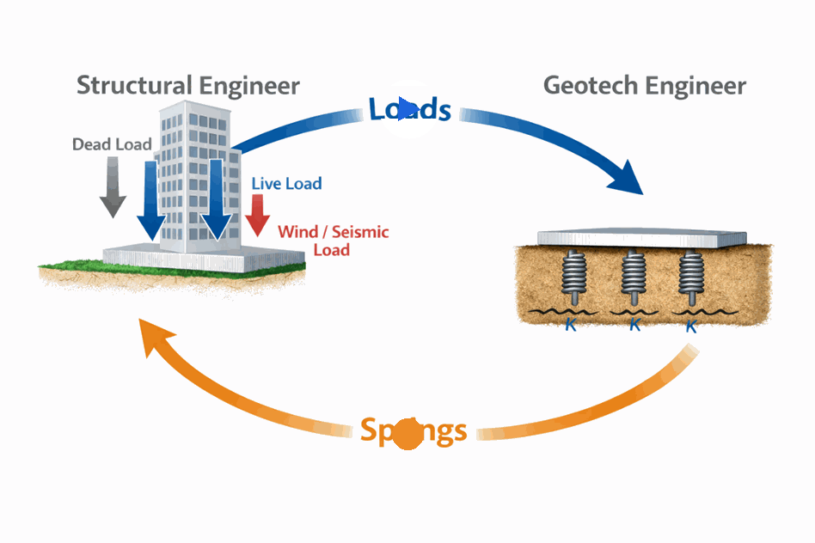
With
NX Interact

Slide 6
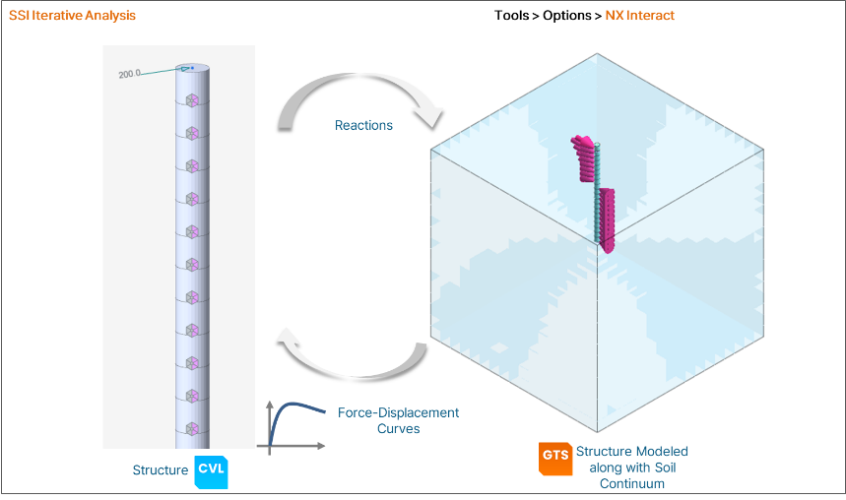
Example:

Slide 7
SSI Iterative Analysis of Laterally Loaded Pile using NX Interact

Slide 8
Detailed Analysis using Soil Continuum Method

Slide 9
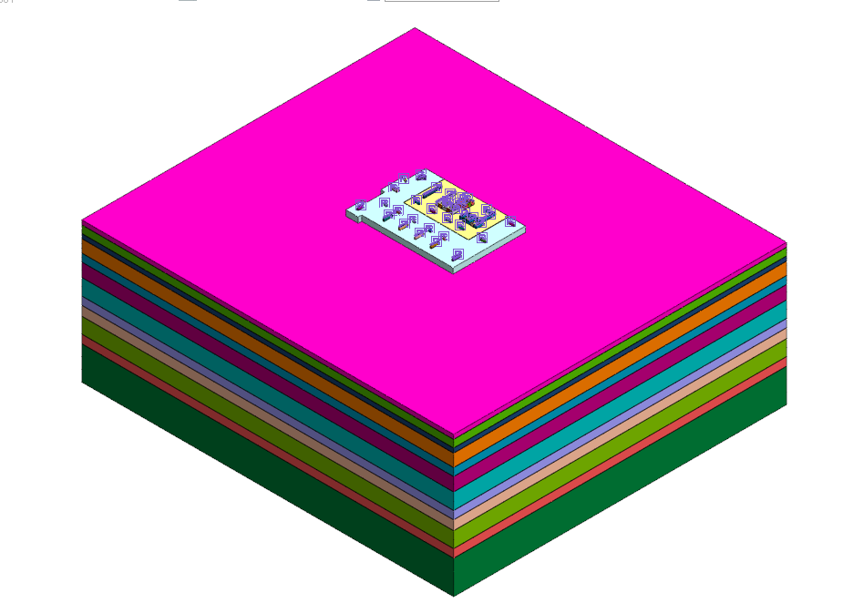
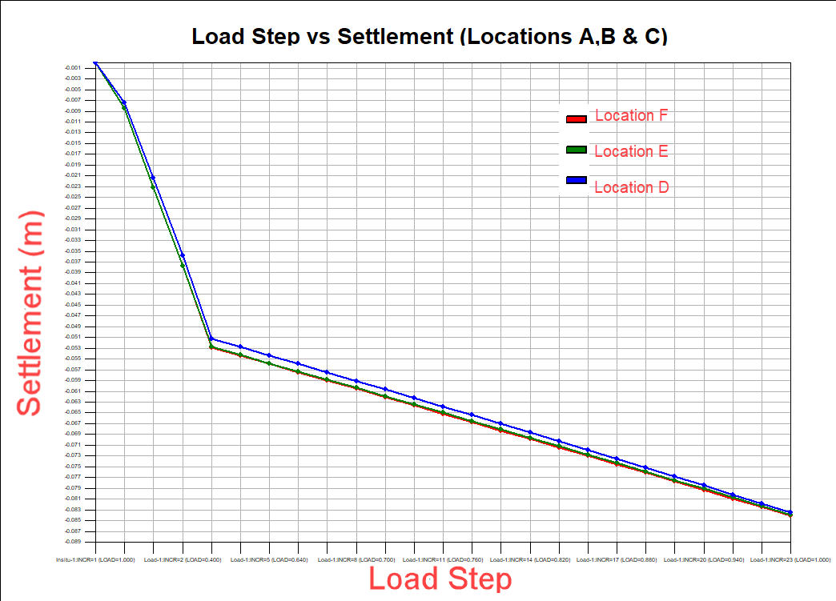
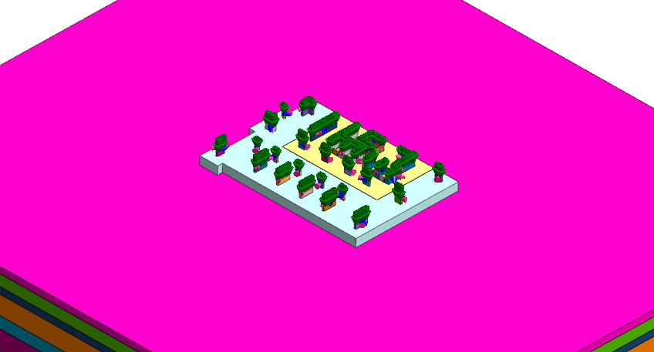
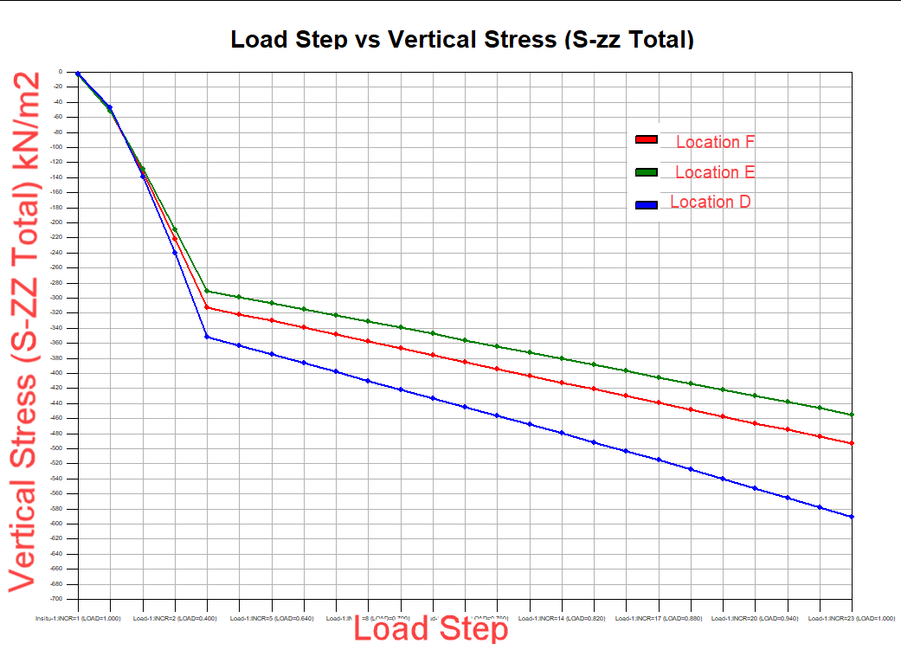
Step-1:
Foundation and Soil Modeling
Step-2:
Load Table Import/Export Option.
(Load imported into GTS NX via excel sheet from any Structural tool)
Step-3:
Export the Stiffnesses back to Structural tool

Slide 10
Soil Continuum Method – Stress Analysis of a Pile Raft Foundation

Slide 11
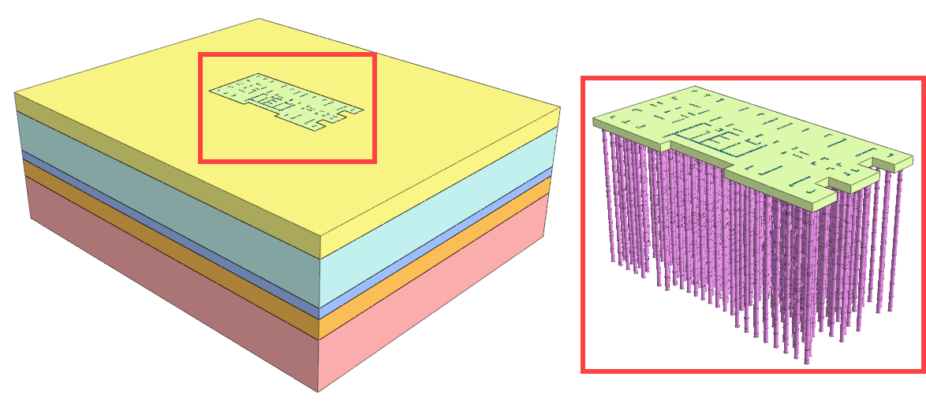
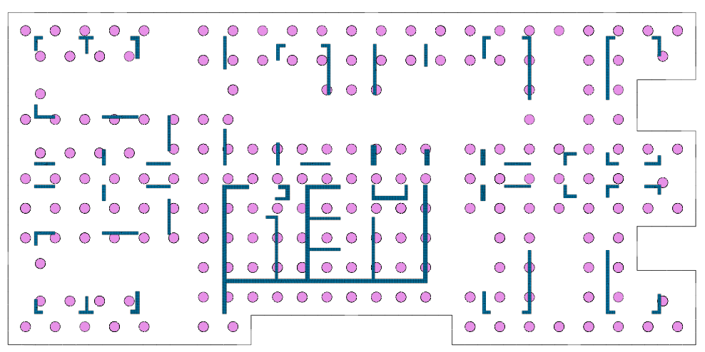
Finite Element Modeling Study of a Piled Raft Foundation: Case Study
24m Deep Piles
200 Piles
Plan - raft, columns & shear walls

Slide 12
Thank You!!

