Slide 1






  here
  Numerical Modelling of Underground Excavations and Tunnelling Works: Research and Practice
Numerical Modelling of Underground Excavations and Tunnelling Works: Research and Practice
01 Content 1
  Type here
  Type here
Chiranjib Sarkar | Principal Engineer, GEOCONSULT India
03 Content 3
04 Content 4
  Type here
  Type here

Slide 2
CONTENTS
01 Content 1
  Overview of Case studies and their publication
02 Content 2
  Case Study -1: Effect of Overburden Pressure and Soil Parameters on Tunnel Induced Ground Settlement
03 Content 3
  Case Study -2: Simple and Rapid Methods for Designing of Tunnel Structure in Rock.
04 Content 4
  Case Study -3: Effect of Different Water Table Depth In Design of Tunnel.
05 Content 5
  Case Study -4: Seismic Behavior of Tunnel Structure under Varying Surrounding Soil, Water Table, and Overburden Condition.

Slide 3
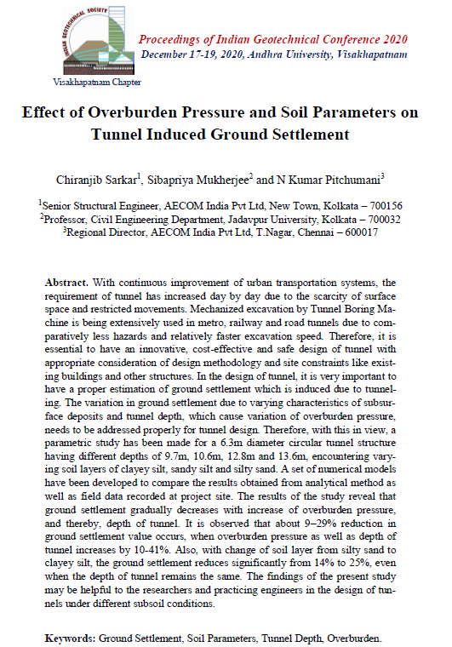
Overview of Case studies and their publication
Case Study -1:
Effect of Overburden Pressure and Soil Parameters on Tunnel Induced Ground Settlement.

Slide 4
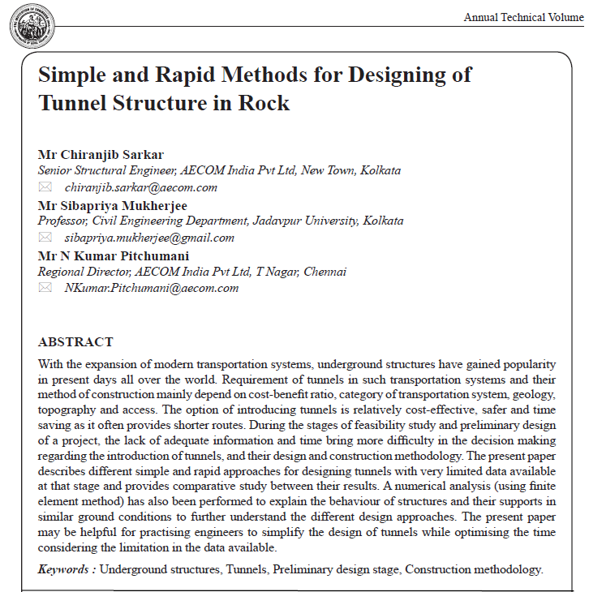
Overview of Case studies and their publication
Case Study -2:
Simple and Rapid Methods for Designing of Tunnel Structure in Rock.

Slide 5
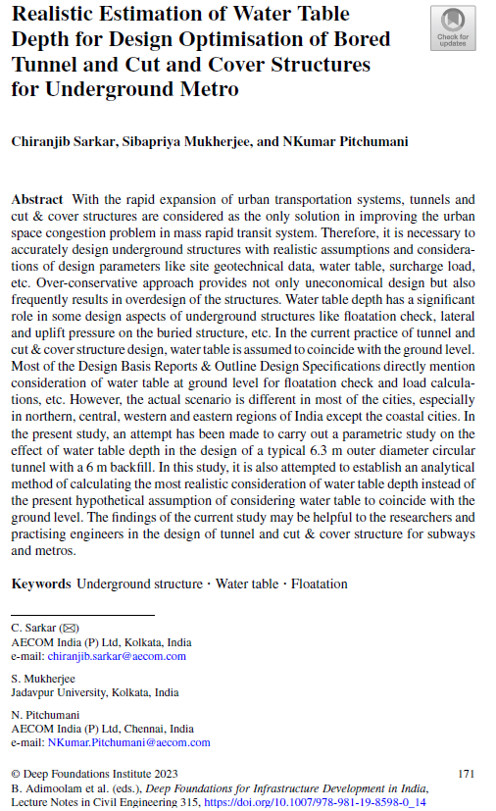
Overview of Case studies and their publication
Case Study -3:
Effect of Different Water Table Depth In Design of Tunnel.

Slide 6
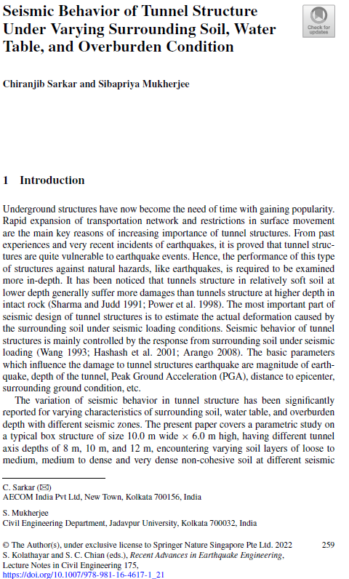
Overview of Case studies and their publication
Case Study -4:
Seismic Behavior of Tunnel Structure under Varying Surrounding Soil, Water Table, and Overburden Condition.

Slide 7
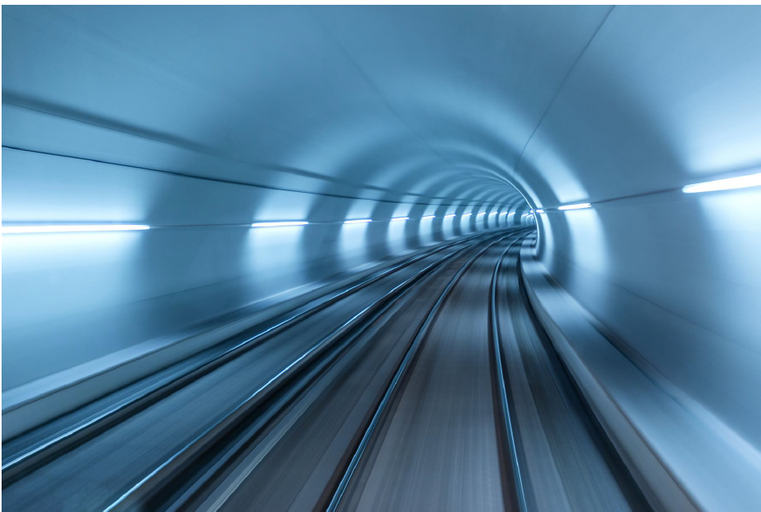
Model Analysis, Result and Discussion for different Case Studies

Slide 8
Case Study -1:
Effect of Overburden Pressure and Soil Parameters on Tunnel Induced Ground Settlement

Slide 9
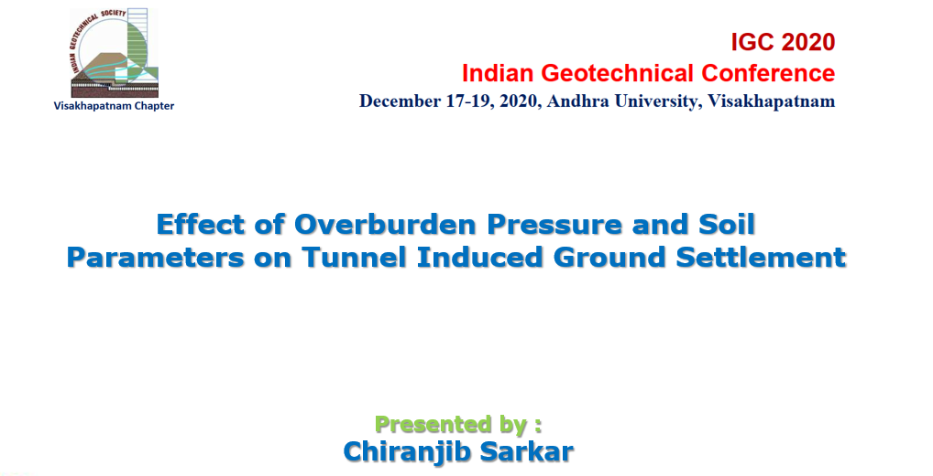
19/12/2020

Slide 10
Why this study?
With continuous improvement of urban transportation systems, the requirement of tunnel has increased day by day due to the scarcity of surface space and restricted movements. Mechanized excavation by Tunnel Boring Machine is being extensively used in metro, railway and road tunnels due to comparatively less hazards and relatively faster excavation speed.
Therefore, it is essential to have an innovative, cost-effective and safe design of tunnel with appropriate consideration of design methodology and site constraints like existing buildings and other structures.
Hence, underground tunnel design requires a proper estimation of ground settlement for safe and economically efficient construction of tunnel and underground structure.
In the design of tunnel, it is very important to have a proper estimation of ground settlement which is induced due to tunneling.

Slide 11
Introduction
The variation in ground settlement due to varying characteristics of subsurface deposits and tunnel depth, which cause variation of overburden pressure, needs to be addressed properly for tunnel design.
Present study covers a parametric study on 6.3m outer diameter typical circular tunnel structure having different depths of 9.7m, 10.6m, 12.8m and 13.6m, encountering varying soil layers of clayey silt, sandy silt and silty sand.
With different tunnel depths, the effects of various overburden pressures and difference in soil parameters on ground settlement has been logged to develop a correlation between ground settlement with tunnel depth and soil parameter.
A set of numerical models in Finite Element Method (FEM) have also been developed to compare the results obtained from analytical method as well as field data recorded at project site.

Slide 12
Literature Review
Sven Moller: Tunnel induced settlements and structural forces in linings. 2006 Mitteilung 54 des Institutes fur Geotechnik Herausgeber P.A. Vermeer.
Eric Leca, Animateur Barry New, General Reporter: Settlements induced by tunneling in Soft Ground. Tunneling and Underground Space Technology 22 (2007) 119–149, ITA/AITES Report 2006.
Mohammed Y. Fattah, Kais T. Shlash and Nahla M. Salim: Settlement Trough due to Tunneling in Cohesive Ground. Indian Geotechnical Journal, 41(2), 2011, 64-75.
Takahiro Aoyagi: Representing Settlement for Soft Ground Tunneling. Massachusetts institute of Technology, May 2005.
Nguyen Duc Toan: TBM and Lining - Essential Interfaces. Politecnico di Torino, Turin, Italy, October 2006.

Slide 13
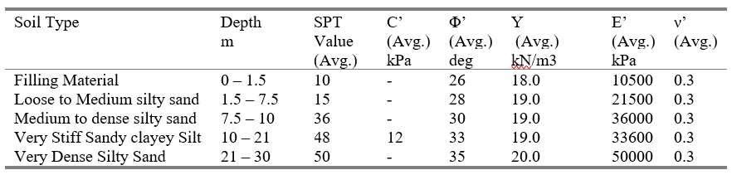
Model of the study
A typical 6.3m diameter circular tunnel section of Delhi Metro Rail Corporation (DMRC) Dwarka-Najafgarh corridor has been considered for this study and analysis.
Depth wise Geotechnical parameters for tunnel stretch within project area:
Tunnel depth of project area is varies from 9.7m to 13.6m depth below ground at different length-section of the project. Therefore, surface settlement would vary due to change in tunnel depth as well as change in ground condition.

Slide 14
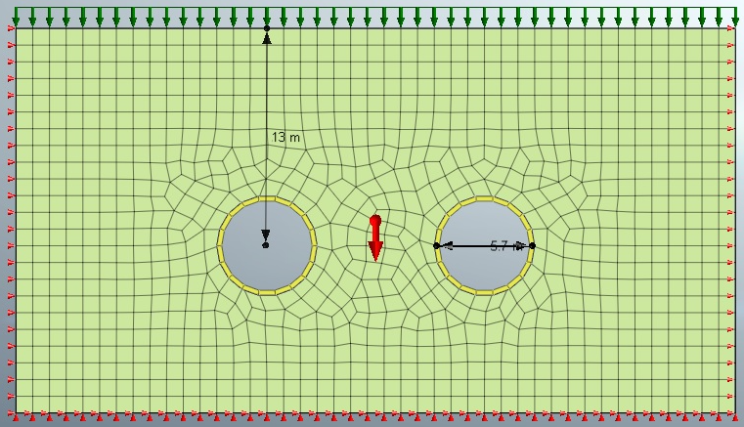
Model of the study…..Continue
The entire investigation part of parametric study has been conducted in 12 different cases for 4 different tunnel depths (9.7m, 10.6m, 12.8m and 13.6m) with 3 different ground conditions (loose to medium silty fine sand, medium to dense silty sand and very stiff sandy clayey silt).
A FEM model view

Slide 15
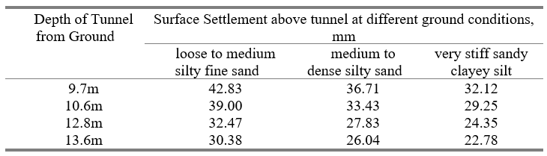
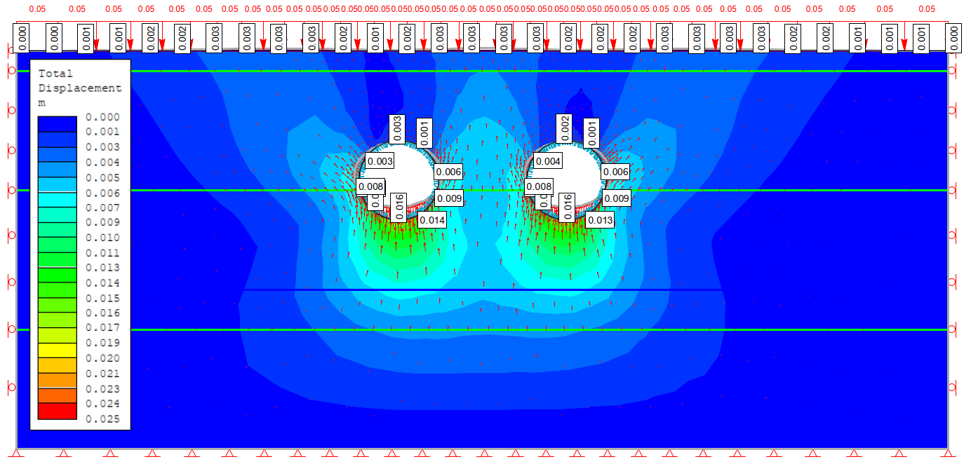
Presentation of results
Ground settlement value obtained for 12 different situations of 4 different tunnel depths with 3 different ground conditions have tabulated below:
Ground Settlement from numerical model (FEM) for tunnel depth of 9.7m shown below:

Slide 16
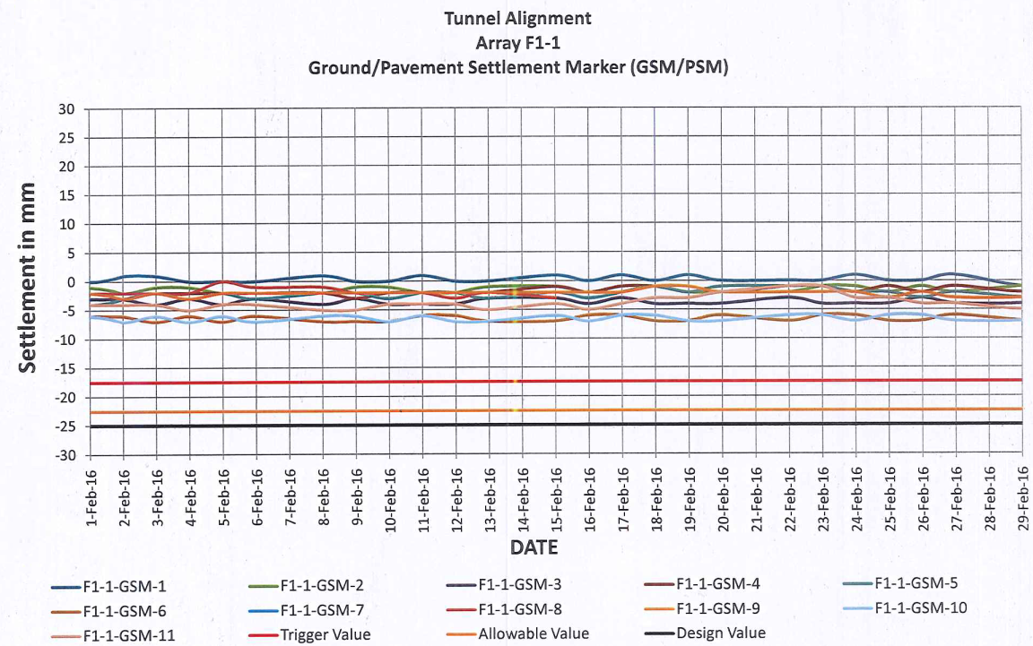
Presentation of results…..Continue
The ground settlement results obtained from predictive method has been further cross checked with realistic ground settlement data recorded at project site at Dwarka-Najafgarh corridor.
Ground settlement data recorded at project site for the similar ground condition with similar depth of tunnel (9.7m from ground) shown below:
Similarity in settlement behaviour has been observed between results from predictive settlement method with realistic settlement data of project site.

Slide 17
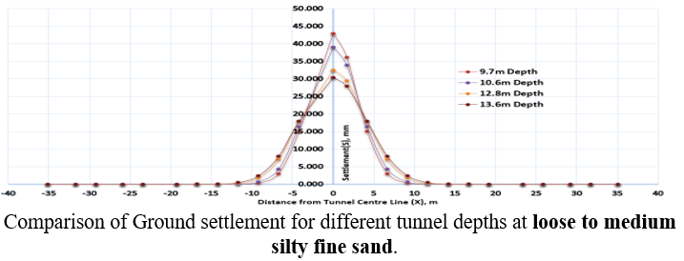
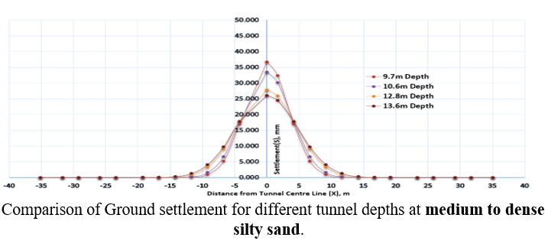
Discussions on results
Surface Settlement for different tunnel depths with same ground condition:
Ground settlement for 4 different tunnel depths (9.7m, 10.6m, 12.8m and 13.6m) have been plotted for 3 different ground conditions (loose to medium silty fine sand, medium to dense silty sand and very stiff sandy clayey silt) are shown below.

Slide 18
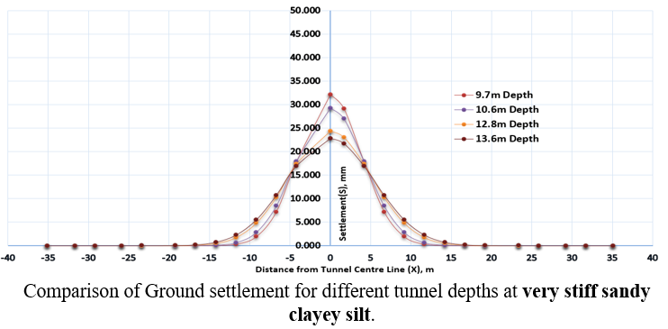
Discussions on results…..Continue
  The results from above shown figures, it is clear that ground settlement gradually decreases with increase in overburden pressure, and thereby, depth of tunnel. It is observed from above shown figure that ground settlement value decreases by 9%, 24% and 29% when overburden pressure as well as depth of tunnel increases by 10%, 32% and 41% respectively, even when ground condition remains the same.

Slide 19
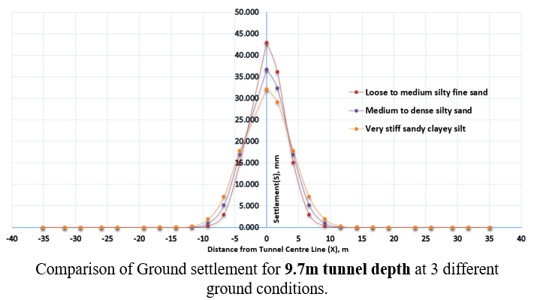
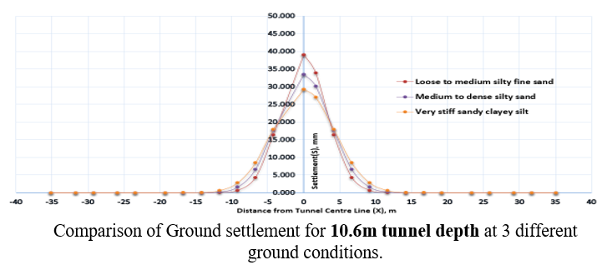
Discussions on results…..Continue
Surface Settlement for same tunnel depth with different ground conditions:
Ground settlement for 3 different ground conditions (loose to medium silty fine sand, medium to dense silty sand and very stiff sandy clayey silt) have been further plotted for 4 different tunnel depths (9.7m, 10.6m, 12.8m and 13.6m) are shown below.

Slide 20
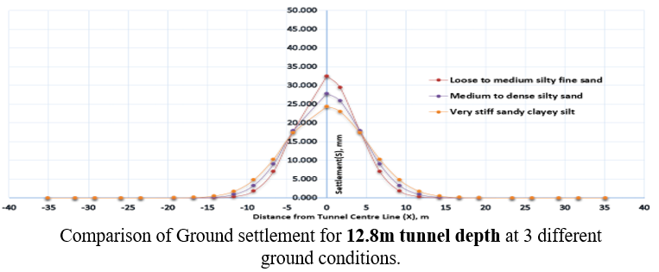
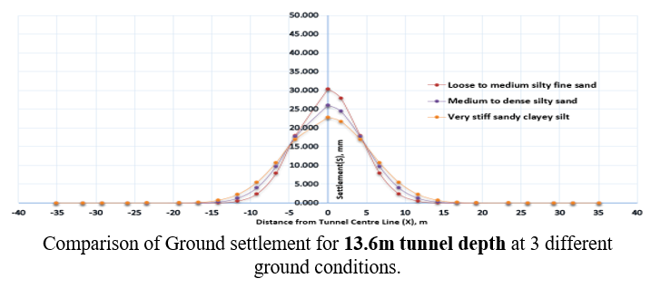
Discussions on results…..Continue
  The results from above shown figures, It is observed that ground settlement value decreases by 14% when ground condition is changed from the state of loose to medium silty fine sand to the state of medium to dense silty sand even at same depth of tunnel.
  Ground settlement value decreases by 25% when ground condition is changed from the state of medium to dense silty sand to the state of very stiff sandy clayey silt, even when depth of tunnel remains the same.

Slide 21
Conclusions
Ground settlement results obtained from numerical models (FEM) is very close to actual ground settlement data recorded at project site. Hence, it can be concluded that numerical models (FEM) gives more reliable results among all others predictive methods for obtaining surface settlement.
The ground settlement varies with the variation of subsurface deposits and various depths of tunnel. A shallow depth tunnel tends to have relatively greater eﬀect on ground than the deeper one. Ground settlement decreases with change of soil layer from silty sand to clayey silt.
Ground settlement gradually decreases with increase in overburden pressure i.e. depth of tunnel. Ground settlement value reduces by 9-29% when overburden pressure as well as depth of tunnel increase by 10-41% even with same ground condition.
With change of ground conditions from silty sand to clayey silt, the ground settlement reduces significantly by 14% to 25%, even when depth of tunnel remains the same.

Slide 22
Acknowledgement
The authors acknowledge the support from the entire team involved in the project of Delhi Metro Rail Corporation Dwarka-Najafgarh corridor.

Slide 23
Case Study -2:
Simple and Rapid Methods for Designing of Tunnel Structure in Rock.

Slide 24
DESIGNING OF TUNNEL STRUCTURE IN ROCK
In the tunnelling on rocky strata, structural design is mainly required for design of tunnel supporting system, deciding of tunnel geometry with excavated periphery and minimum distance between two adjacent tunnels. Following three methods are available for design of tunnel supports:
Empirical Methods
Analytical Methods
Numerical Methods
Empirical Methods
Various empirical methods have been developed over the years for classification of the rock mass. Ritter (1879) attempted an empirical approach for tunnel design focused on defining support requirements. Terzaghi (1946) developed a rational empirical method for classification and evaluation of rock and rock loads which is used for designing of tunnel support. Lauffer (1958) suggested that actual stand-up time for an unsupported span is interrelated with the quality of the rock mass. Most of the classification schemes (Wickham et al (1972), Bieniawski (1973) and Barton et al (1974)) have been developed from different case histories in which rock mass and all its components were included. Rock Mass has been assessed by different methods based on following classification:
A) Rock Structure Rating (RSR) – (By Wickham)
B) Rock Mass Rating (RMR) – (By Bieniawski)
C) Rock Tunnelling Quality Index, Q – (By Barton)

Slide 25
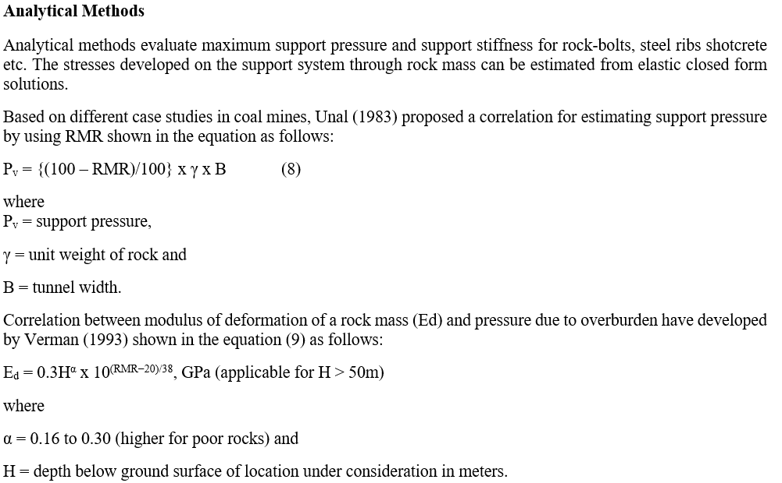
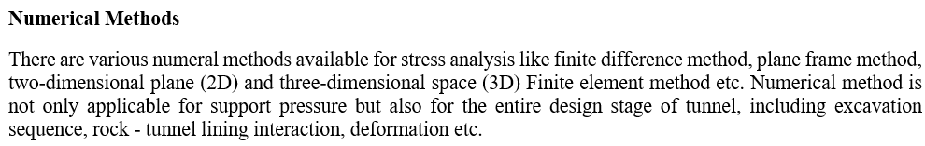

Slide 26
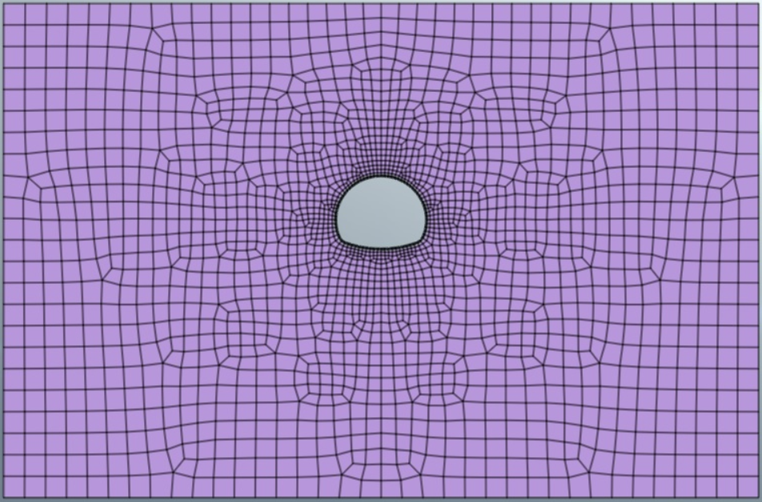
Numerical Model of NATM Tunnel on Rock layer
A three-dimensional numerical model (finite element method) with 0.5m X 0.5m mesh size has been further developed with geotechnical software MIDAS GTS NX for 6.7m diameter horse-shoe tunnel situated on rocky layer. Generalized Hoek-Brown failure criteria for rock elements and Mohr coulomb failure criteria for soils elements has been adopted in the analysis. A model view of a 6.7m diameter horse-shoe tunnel situated in rocky layer from geotechnical software MIDAS GTS NX is shown in Fig.1.
A model view of a 6.7m diameter horse-shoe tunnel situated in rocky layer

Slide 27
Outcome from Numerical model
The purpose of numerical analysis (using finite element method) is to find out the behaviour of tunnel structures and their supports in similar ground conditions to further understand the different design approaches. As outcome of numerical analysis, bending moment, shear force, deformation etc. have been identified from present model. Design of the tunnel structure and capacity of support structure are checked with respect to the outcome of numerical analysis i.e. bending moment, shear force, deformation etc.
Bending moment due to excavation of 6.7m diameter NATM horse-shoe tunnel situated in rocky layer is shown in Fig. 2. Tunnel and structural support design is checked for this bending moment.
Deformation/settlement and axial force due to excavation of the tunnel situated in rocky layer is shown in Fig. 3 and Fig. 4 respectively. Design of shotcrete is checked for this axial force.
Axial force in rock-bolt support of the same tunnel is shown in Fig. 5. Design and capacity of rock-bolt is checked for this axial force.

Slide 28
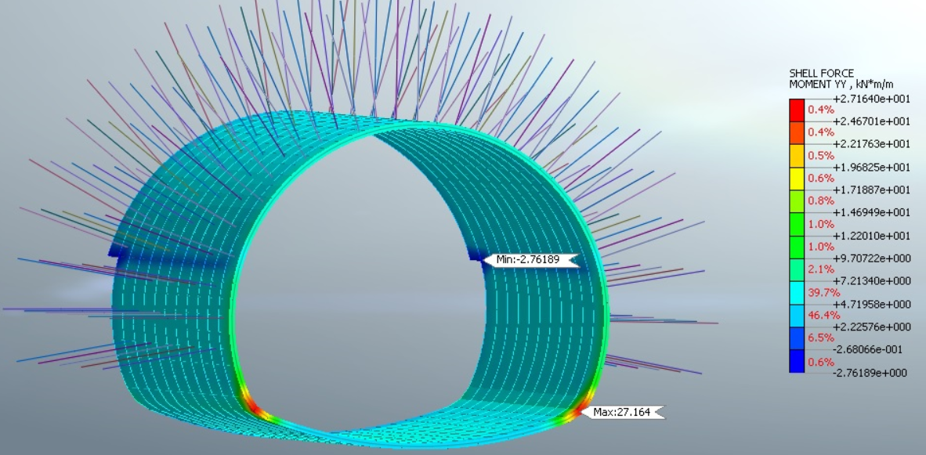
Fig. 2: Bending moment of 6.7m diameter NATM horse-shoe tunnel situated in rocky layer.

Slide 29
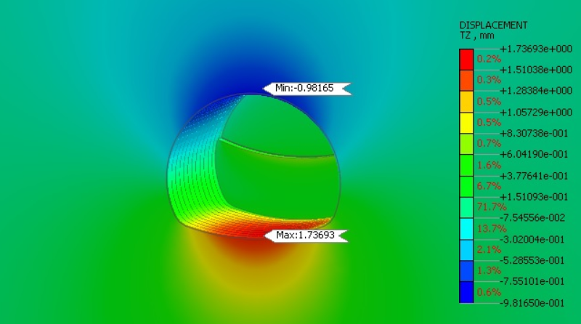
Fig. 3: Displacement due to excavation of 6.7m diameter NATM horse-shoe tunnel situated in rocky layer.

Slide 30
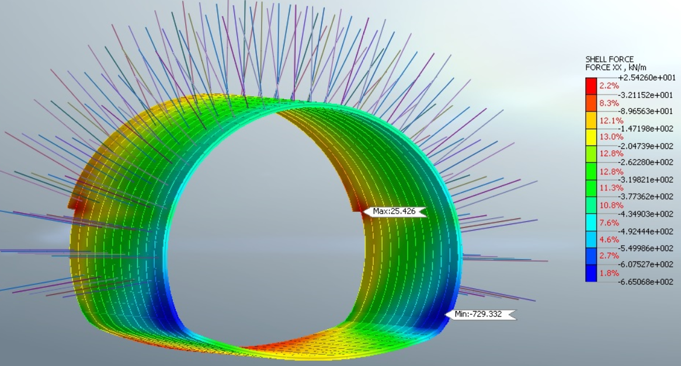
Fig. 4: Axial Force of 6.7m diameter NATM horse-shoe tunnel situated in rocky layer.

Slide 31
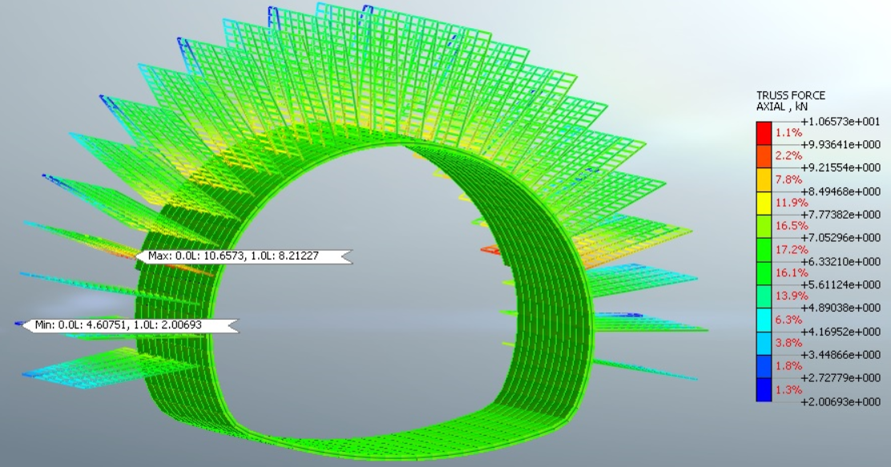
Fig. 5: Axial force on rock-bolt support of 6.7m diameter NATM horse-shoe tunnel situated in rocky layer.

Slide 32
Conclusions
The present paper describes different approaches for designing a tunnel structure in a simple and rapid process with very limited data available at that stage and provide comparative study between their results. A numerical analysis has also been performed to explain the behaviour of structures and their supports in similar ground conditions.
From different rock mass classification, it clear that immediate support pressure is less in good rock, but it is high in weak rock. Hence design of immediate support would be done based on that principle.
Selection of appropriate method for designing tunnel support would be made based on availability of geological and hydrological data available at that moment.
Higher value of rock mass classification indicates a relatively better category of rock which also require relatively less support.

Slide 33
Conclusions…..continue
Structural behaviour like bending moment, shear force, deformation etc can be assessed from numerical analysis. Hence, numerical analysis (finite element method) is most suitable for actual design. Empirical and analytical approaches of designing a tunnel structure is suitable only for feasibility study and preliminary design of a project. However, this empirical/analytical approach can be used as a good check for the results found from numerical method.

Slide 34
Case Study -3:
Effect of Different Water Table Depth In Design of Tunnel.

Slide 35
Model of the study
Parametric study on the effect of water table: An attempt has been made to carry out a parametric study on the effects of water table depth in design of a typical 6.3m outer diameter circular tunnel with 6m backfill.
A two-dimensional numerical analysis (using finite element method) with 0.5m X 0.5m mesh size has been developed with geotechnical software MIDAS GTX NX with consideration of water table at tunnel top level and tunnel centre level.

Slide 36
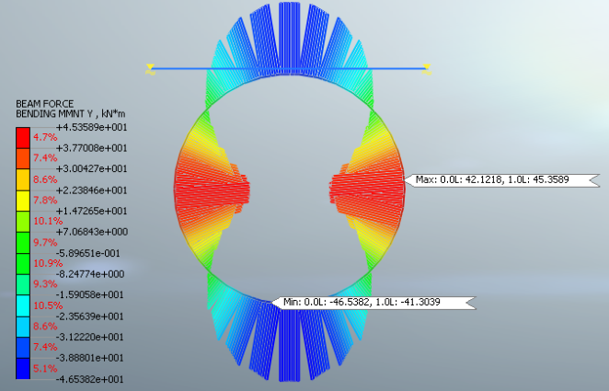
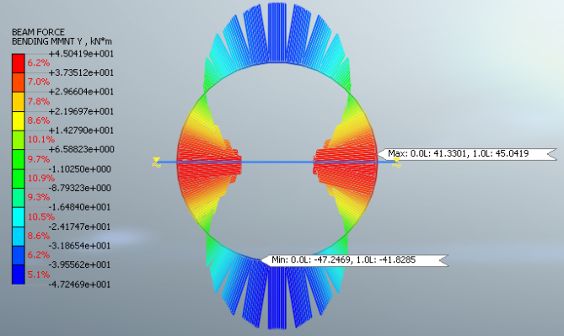
Results and discussions
Effects of different water table depths on design of tunnel at the same depths with same ground condition: Bending moment comparison of typical 6.3m diameter circular tunnel with 6m backfill:
From the results of the above shown figures, it is clear that the bending moment decreases with increase of depth to water table below ground, even when tunnel depth and ground condition remain the same. As the behaviour of structure changes with the changes of water table depth, therefore, water table should be used as location or project specific instead of present practice of considering water table at ground.

Slide 37
Case Study -4:
Seismic Behavior of Tunnel Structure under Varying Surrounding Soil, Water Table, and Overburden Condition.

Slide 38
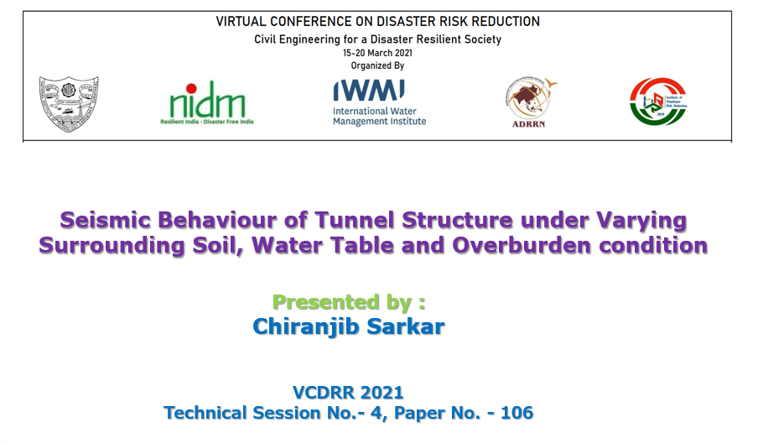
17/03/2021

Slide 39
Why this study?
In the past, engineers believed that seismic design for underground structures is not necessary, because they suffer lesser damage than surface structures.
From experiences of last three decades and very recent incidents of earthquakes, it is proved that tunnel structures are quite vulnerable to earthquake events. Hence, the performance of this type of structures against natural hazards, like earth-quakes, is required to be examined more in-depth to reduce Disaster Risk and Uncertainty.
Also, it is essential to have an innovative, cost-effective and safe design of tunnel with precise assessment of deformation, force and moment in structures caused by surrounding soil under seismic conditions.
The variation of seismic behaviour in tunnel structure have been significantly reported for varying characteristics of surrounding soil, water table and overburden depth with different seismic zones.

Slide 40
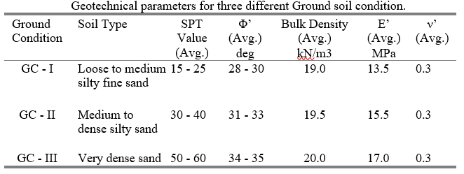
Introduction….Continue
The present paper covers a parametric study on a typical box structure of size 10.0m wide x 6.0m high, having different tunnel axis depths of 8m, 10m and 12m, encountering varying soil layers of loose to medium, medium to dense and very dense non-cohesive soil at different seismic zones.
The variation of deformation, force and moment for different tunnel depth with varying characteristics of surrounding soil and water table has been assessed for different seismic zones. A set of different cases of numerical models in Finite Element Method (FEM) have been further developed to study the non-linear behaviour of tunnel structure under seismic condition.

Slide 41
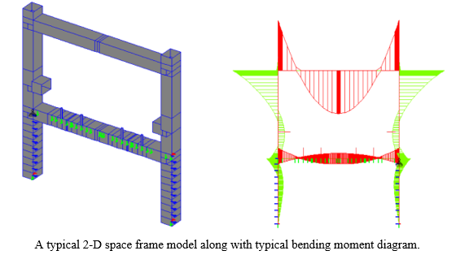
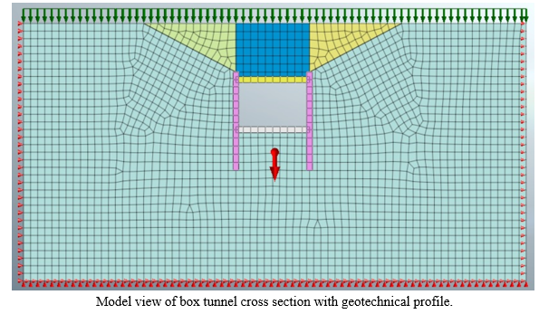
Model of the study
A two-dimensional space frame model has been developed in STAAD.Pro for different soil and different seismic conditions. As a part of soil-structure interaction, linear springs have been assigned with equivalent stiffnesses based on sub-grade modulus of reaction.
Apart from above stiffness-based models, a set of numerical models with 0.5m X 0.5m mesh size in Finite Element Method (FEM) have been further developed in MIDAS GTX NX software to study the non-linear behaviour of tunnel structure under seismic condition.

Slide 42
Model of the study…..Continue
Three different tunnel axis depths of 8m, 10m and 12m have been adopted with respect to backfill depths of 4m, 6.4m and 8.2m respectively.
Three different seismic zones (zones II, zone III and zone IV as per IS-1893) have been considered for present study. Considering important factor of 1.5, equivalent Peak Ground Acceleration (PGA) value of 0.18, 0.24 and 0.36 in Maximum Design Earthquake (MDE) / Maximum Credible Earthquake (MCE) have been adopted which are close to zone II, zone III and zone IV respectively.
Three different water table depths have been considered in present analysis which are water table at tunnel centre level, water table at tunnel top level and water table at 3m below ground level.
For different tunnel depths, soil condition and water table depth, the lateral earth pressure and vertical surcharge have been calculated and the same have been assigned on the STAAD and MIDAS GTX NX models with the appropriate load combinations.

Slide 43
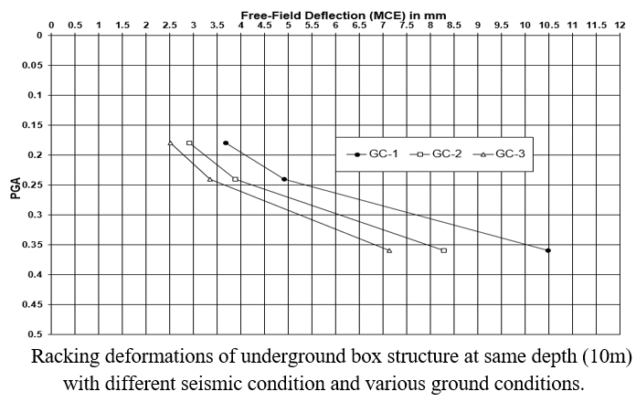
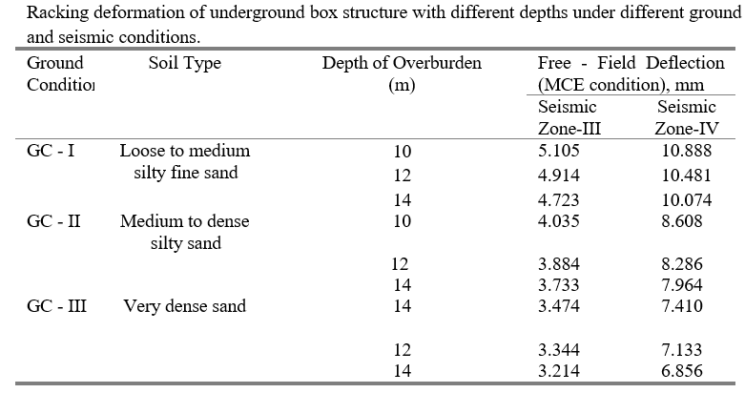
Presentation of results
Racking deformations of underground box structure at same depth (10m) with different seismic condition (PGA of 0.18, 0.24 and 0.36) and various ground conditions (GC-I, GC-II and GC-III) have been plotted and shown in Fig.
Further, racking deformation of underground cut & cover box structure with different depths of 10m, 12m and 14m for three different ground conditions (GC-I, GC-II and GC-III) having two different seismic zones (zone-III and zone-IV) are shown in Table.

Slide 44
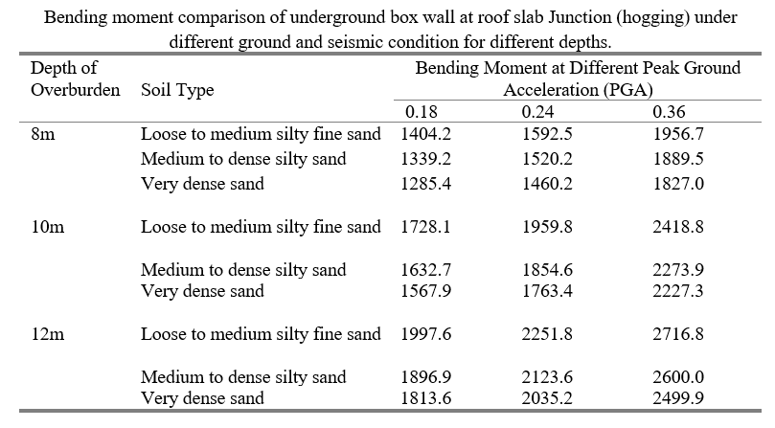
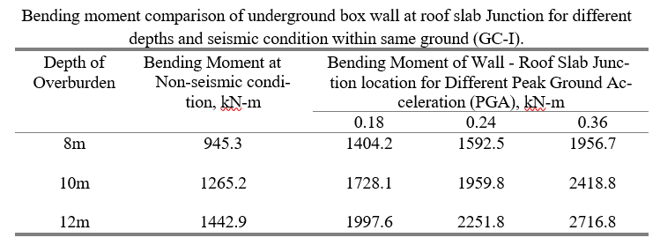
Presentation of results…..Continue
Bending moment comparison of underground cut & cover box structure with three different depths (8m, 10m and 12m) for three different ground conditions (GC-I, GC-II and GC-III) and three different seismic condition (PGA of 0.18, 0.24 and 0.36) are shown in Table.
Bending moment comparison of underground box structure with three different depths (8m, 10m and 12m) and different seismic conditions (non-seismic case and seismic zone-II, zone-III and zone-IV) within same ground condition (GC-I) are shown in Table.

Slide 45
Discussions and Conclusions
Raking deformation decreases gradually with improvement of surrounding soil conditions. Deformation value reduced by 14-22% with the improvement of ground condition. Raking deformation value is reduced by 22% when ground soil condition improved from GC-I (loose to medium silty fine sand) to GC-II (medium to dense silty sand). Raking deformation value is further reduced by 14% when ground soil condition improved from GC-II (medium to dense silty sand) to GC-III (very dense sand).
Raking deformation value decrease by 4% to 7% with increase in tunnel depth from 10m to 12m and then to 14m within same ground soil condition.
With the changes in seismic condition from lower to higher PGA, racking de-formation values increase scientifically even for same ground soil condition (GC-I, GC-II or GC-III). With the changes in seismic level from zone-II to zone-III, racking deformation is increased by 33% in same soil condition. racking deformation is further increased by 113% when seismic level changes from zone-III to zone-IV.

Slide 46
Discussions and Conclusions…continue
With improvement of surrounding soil conditions within same seismic zone and same tunnel depth, bending moment of wall at roof slab junction location is reduced by 4-6%. With improvement of surrounding soil conditions within same seismic zone and same tunnel depth, bending moment of wall at base slab junction location is reduced by 15-22%.
With the changes in seismic condition from lower to higher PGA, bending moment of wall at roof slab junction location is increased by 8-22%. With the changes in seismic condition from lower to higher PGA, bending moment of wall at base slab junction location is increased by 15-22%.
With the decreasing of water table depths, bending moment of wall is reduced by 3% to 5% within same ground condition. With the changes in seismic condition from lower to higher PGA, bending moment of wall by 3% to 6% due to combined effect of water table with seismic conditions.
The outcome of the present study may be useful to the practicing engineers in design of underground structures.

Slide 47
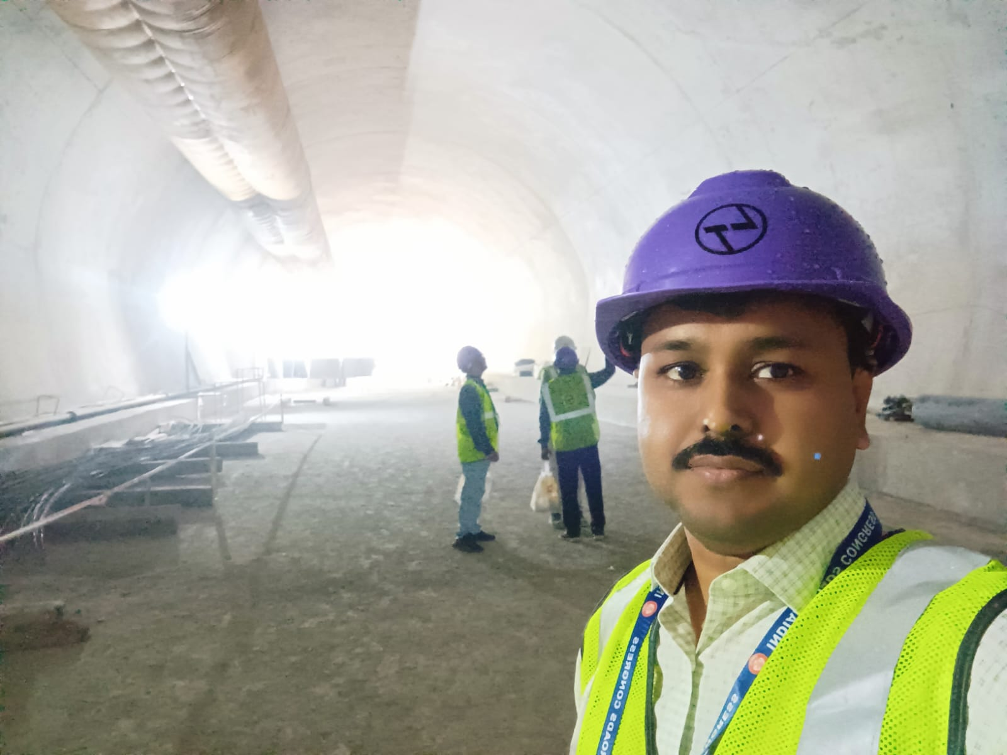
THANK YOU
For any query, contact me at
chiranjibsarkar.civil@gmail.com

Slide 48

Thank you, MIDAS for recognizing me and my little contribution for such wonderful honor

