Slide 1
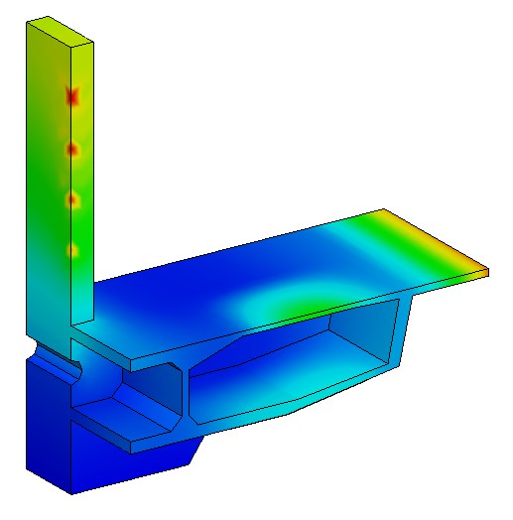
Step
00
Overview
Zero Block Construction Analysis
3-D Linear Static Analysis
Model
  Unit : N, cm
  Isotropic Elastic Material
  Solid Element
Load & Boundary Condition
  Body Force
  Force
  Element Temperature
  Constraint
Result Evaluation

Slide 2
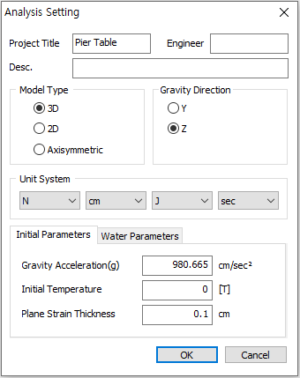





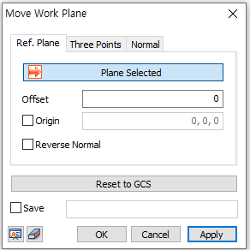






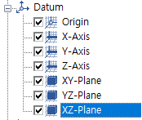
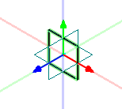

01 Analysis Setting
Step
Procedure
4
Model Type : [3D]
Unit System : [N , cm]
Click [OK] Button
Click [Move Work Plane]
5 Select [XZ-Plane]
Click [OK] Button
Click [Normal View]
1
5
2
3
6
Select “XZ-Plane” in Work Window or
7
Model
Zero Block Construction Analysis
1

Slide 3
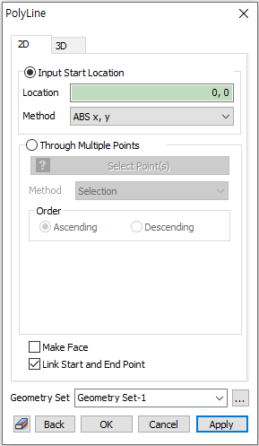
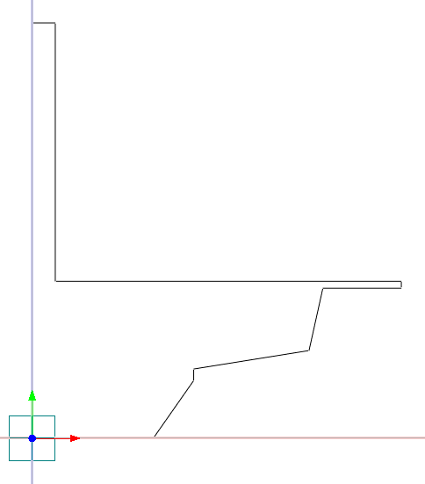





Step
02
Geometry > Point & Curve > Polyline
Procedure
Check on [Link Start and End Point]
Location : (0) , <525> , <175, 250> ,
<0, 50> , <500, 80> , <60, 270> ,
<340> , <0, 30> , <-1500> , <0, 1120> ,
<-100> 
Click Right Mouse Button in Work Window (to Stop Polyline Drawing)
2
4
Click [Zoom All]
1
 “( ): ABS x, y”, < >: “REL dx, dy”
<525> same as <525, 0>
4

Slide 4
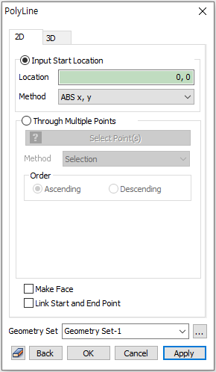


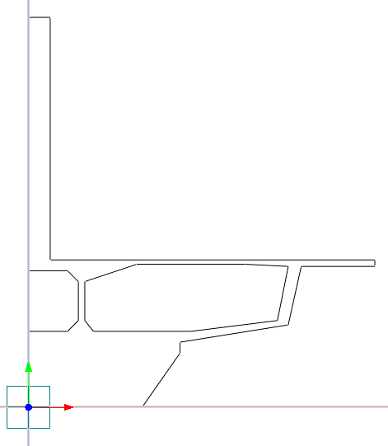
Step
03
Geometry > Point & Curve > Polyline
Procedure
1 | Check off [Link Start and End
 | Point]
2 | Location : “(0, 350), <180>, <50,50>,
 | <0, 180>, <-50, 50>, <-180>”
3 | Click Right Mouse Button in Work
 | Window (to Stop Polyline Drawing)
4 | Location : “(300, 350) , <450> ,
 | <400, 50> ,<50, 250> , <-200, 10> ,
 | <-500> ,<-240, -80> , <0, -180> ,
 | <40, -50>”
5 | Click [Cancel] Button
4 2
1
5
2
midas FEA NX Training Series

Slide 5
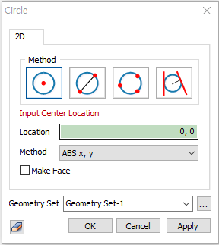
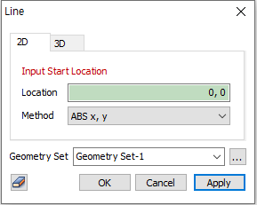




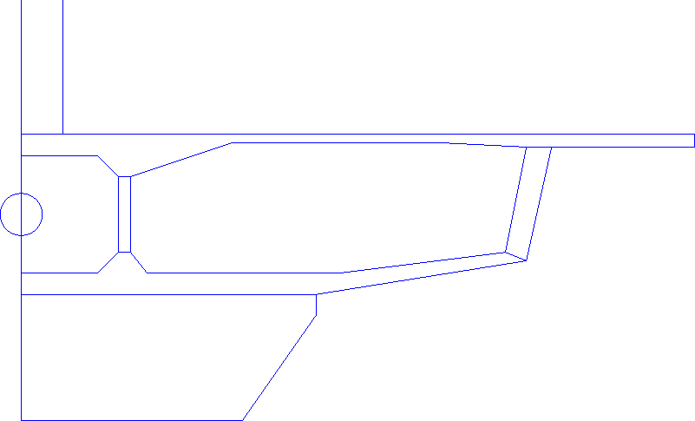
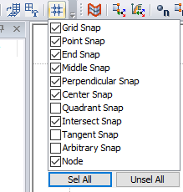





Step
04
Geometry > Point & Curve > Circle
Procedure
¹ Center : “(0, 490)” , Radius : “50”
² Click [Cancel] Button
3 Toggle on [Perpendicular Snap]
4 Geometry > Point & Curve > Line
5 Select [(P1, L1) , (P2, L2) , (P3, P4) ,
(P5, P6) , (P7, P8) , (P9, P10)]
6 Click [Cancel] Button
1
5
6
2
L1
P1
P7 P8
 “( ): ABS x, y”, < >: “REL dx, dy”
<525> same as <525, 0>
P3 P4
3
P5 P6
P9
P10
L2
P2

Slide 6

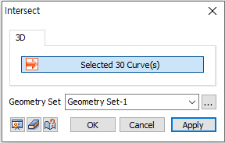
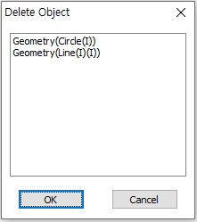

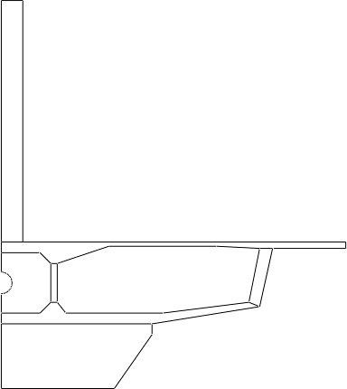
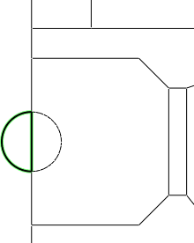



Step
05
Geometry > Point & Curve > Intersect
Procedure
¹ Select [ ] Select All
1
2
Click [OK] Button
3
Select 2 Edges marked by [ O ]
(See Figure)
Press [Delete] Key
Click [OK] Button
2
5
3
1
“Ctrl+A” as shortcut for “Select
Displayed”.
Zero Block Construction Analysis
3

Slide 7
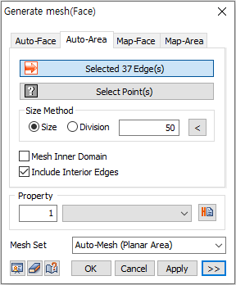
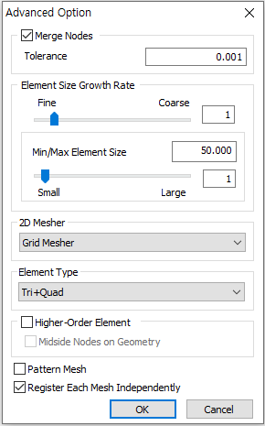




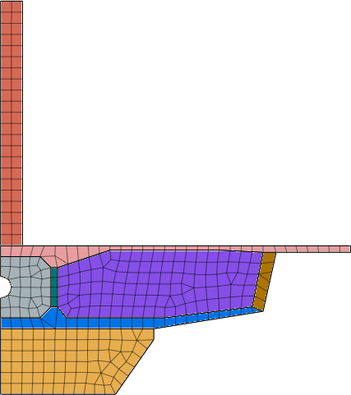

06
Step
Mesh > Generate > 2D > Auto-Area(Planar Area)
Procedure
1 | Select [ ] Select All
2 | Size Method - Size : “50”
3 | Click “>>” button
4 | 2D Mesher : [Grid Mesher]
5 | Element Type : [Tri + Quad]
6 | Click [OK] Button
7 | Click [OK] Button
2
7
4 5
6

Slide 8
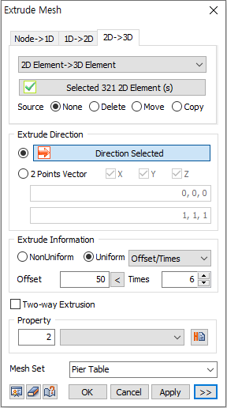
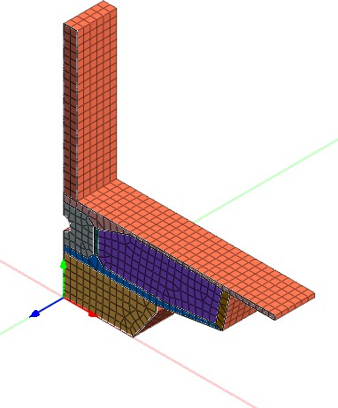




Step
07
Mesh > Protrude > Extrude
Procedure
Select [2D→3D] tab
Select [ ] Select All
3 Source Mesh : [None]
4 Extrude Direction : [Y-Axis]
⁵ Select [Offset/Times]
Offset : “50” , Times : “6”
Property : “2”
Mesh Set : [Pier table]
Click [Apply] Button
1
3
4
5 6
7
8
9
4
midas FEA NX Training Series

Slide 9
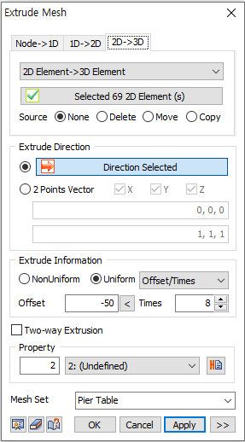
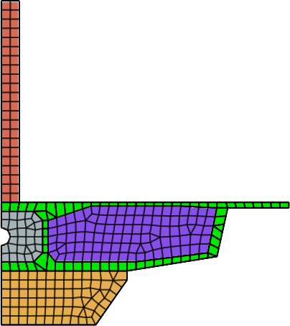






Step
08
Mesh > Protrude > Extrude
Procedure
¹ Select [69 Elements] (Red in Figure)
2 Source Mesh : [Delete]
Extrude Direction : [Y-Axis]
Offset : “-50” , Times : “8”
Property : “2”
Mesh Set : [Pier table]
Click [OK] Button
1
2
3
4
5
6
7

Slide 10
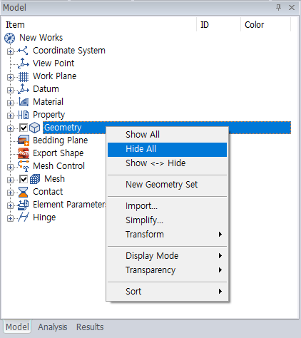
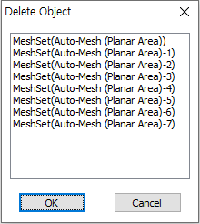


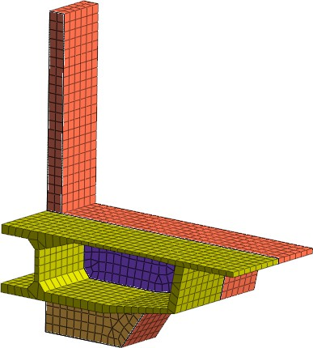
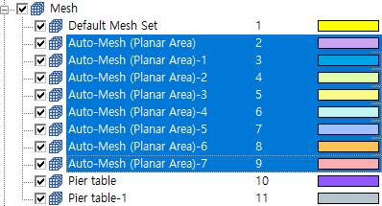

Step
09
Model Tree> Geometry
Procedure
Click Right Mouse Button and Select
[Hide All]
Model Tree : [Mesh]
Select All Mesh Sets except [Default Mesh Set] & [Pier table] & [Pier Table-1]
4 Press [Delete] Key
5 Click [OK] Button
1
5
3
 Multiple Selection: “Shift” / “Ctrl” + Click
Zero Block Construction Analysis
5

Slide 11
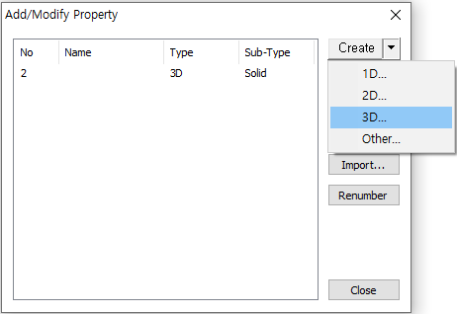
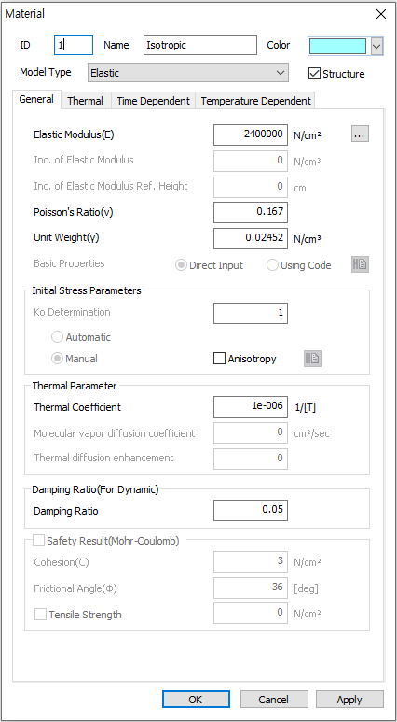




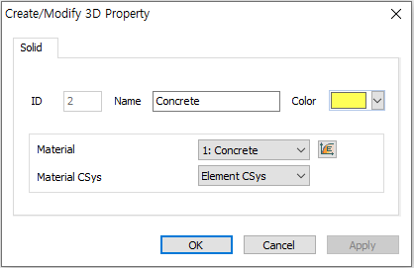


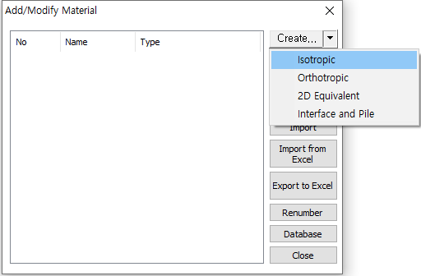




Step
10
Prop./Csys./Func. > Property
Procedure
¹ Create [3D]
² ID : “2” , Name : “Concrete”
3 Material CSys : “Element CSys”
4 Click Button (Material)
⁵ Click [Create Isotropic]
6 ID : “1” , Name : “Concrete”
7 Model Type : [Elastic]
Elastic Modulus : “2.4e6” N/cm²
Poisson’s Ratio : “0.167”
Unit Weight : “2.452e-2” N/cm³
6
1
8
16
9
10
2
4
3
15
11
Thermal Coefficient. : “1e-6”
Click [OK] Button
Click [Close] Button
5
14
Select [1: Concrete] for Material
Click [OK] Button
Click [Close] Button
12
13

Slide 12
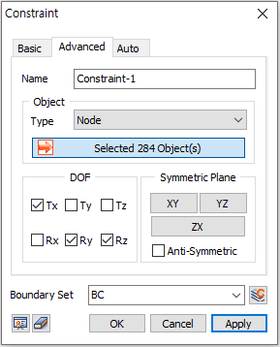

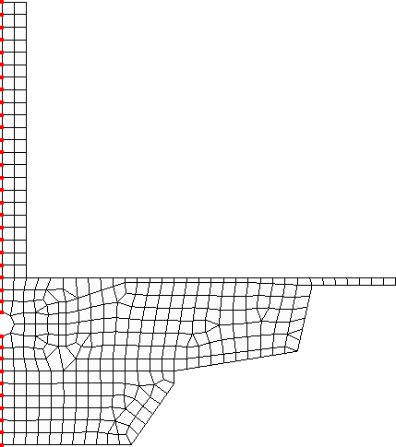


Step
11
Static Analysis > Boundary > Constraint
Procedure
¹ Click [Front] View
2 Select [Left Nodes] (See Figure)
3 Click [Tx, Ry, Rz]
BC Set : [BC]
Click [Apply] Button
2
3
4
5
6
midas FEA NX Training Series

Slide 13
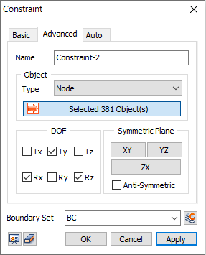
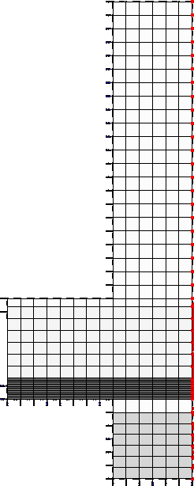

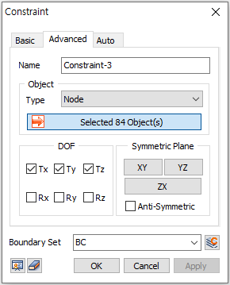

Step
12
Static Analysis > Boundary > Constraint
Procedure
¹ Click [Right View]
² Select [Right Nodes] (See Figure)
3 Click [Ty, Rx, Rz]
Click [Apply] Button
Select [Bottom Nodes] (See Figure)
Click [Tx, Ty, Tz]
Click [OK] Button
2
3
4
5
6
7

Slide 14
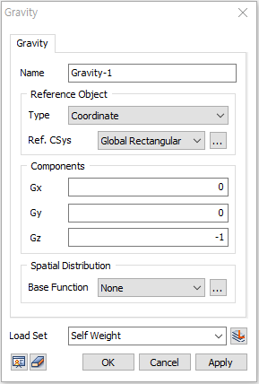


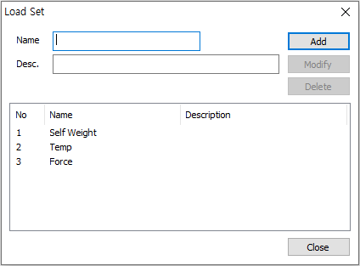

Step
13
Static Analysis > Static Load > Self Weight
Procedure
¹ Click [ ] Button
² Name : “Self Weight”
3 Click [Add] Button
4 Name : “Temp”
5 Click [Add] Button
6 Name : “Force”
Click [Add] Button
Click [Close] Button
9 Gz : “-1”
Load Set : [Self Weight]
Click [OK] Button
9
1
2 4 6
3
10
11
8
Zero Block Construction Analysis
7

Slide 15
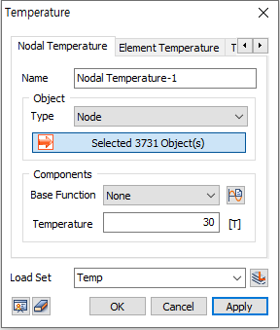
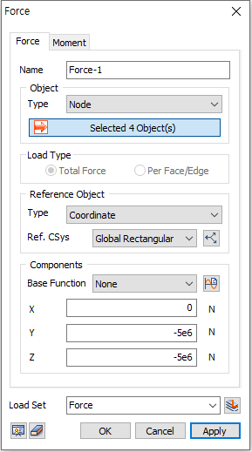


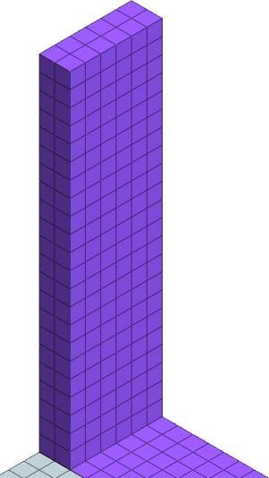





Step
14
Static Analysis > Static Load > Element Temperature
Procedure
1 | Select [Nodal Temperature]
2 | Select [ ] Select All
3 | Temperature : “30”
4 | Load Set : [Temp]
5 | Click [OK] Button
6 | Static Analysis > Static Load > Force
7 | Select 4 Nodes marked by [ O ]
 | (See Figure)
8 | F2 : “-5e6” N
9 | F3 : “-5e6” N
10 | Load Set : [Force]
11 | Click [OK] Button
1
7
3
4
5
8
9
10
11

Slide 16
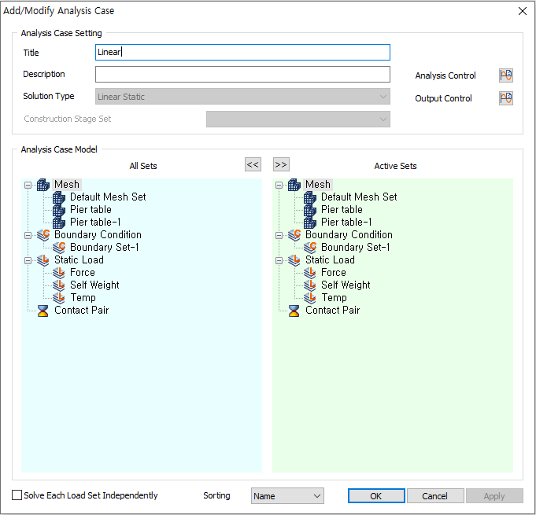

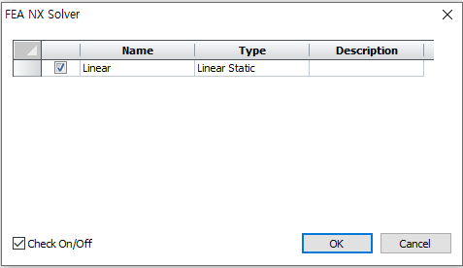

Step
15
Analysis > Analysis Case > General
Procedure
Title : “Linear”
Solution Type : [Linear Static]
3 Drag & Drop [Static Load] and
[Boundary Condition] to [Active
⁴ Sets]
Click [OK] Button
Analysis > [Perform]
Click [OK] Button
1
3
5
7
8
midas FEA NX Training Series

Slide 17
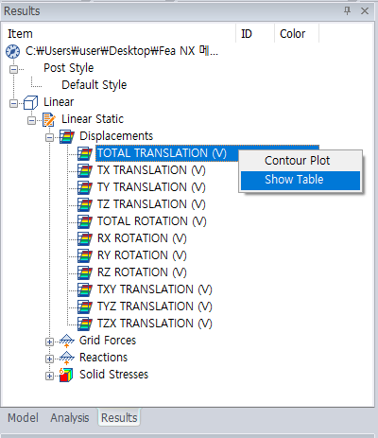
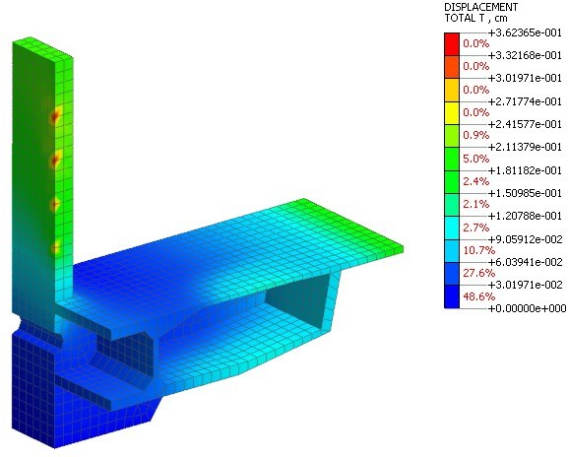
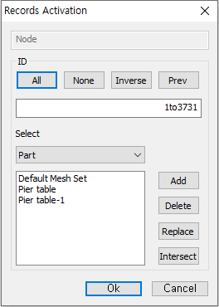
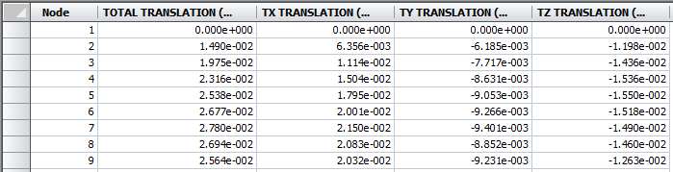

16 Post-Processing
Step
Procedure
1 | Results : Linear
 | Linear Static > Displacements
2 | Double Click [TOTAL
 | TRANSLATION (V)]
3 | Right Click [TOTAL
 | TRANSLATION (V)] and Select
 | [Show Table]
4 | Click [OK] Button
2
3
4

Slide 18
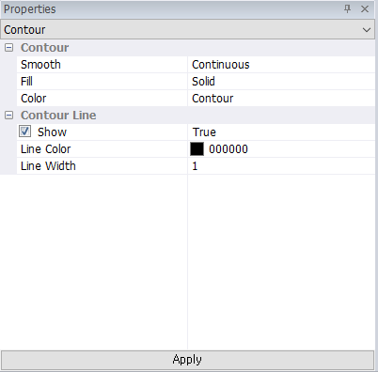
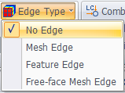




17 Contour Plot Type
Step
Procedure
2
¹ Select [No Edge] for Edge Type
2
Property Window : [Contour]
3
Select [Show] for Contour Line On/Off
3
⁴ Click [Apply] Button
1
4
Contour with Mesh
Contour with No Edge
Contour with Iso-Line
Zero Block Construction Analysis
9

Slide 19



18 Deformed Shape
Step
Procedure
1
Select [Deformed+Undeformed(F
eature)] for Mesh Shape
1

Slide 20








19 Iso-Surface Plot
Step
Procedure
1
Select [Undeformed] for Mesh
Shape
1
2 Select [Feature Edge] for Edge
Type
3 Select [Iso Value Surface]
Select [Upper Part] for Capped Style
Select [Lower Part] for Capped Style
Click [Close] Button
4
2
3
5
6
10
midas FEA NX Training Series

Slide 21





20 Mirror Mode
Step
Procedure
1
Click Result > Etc. > [Initialize]
1
2
2
Select [Undeformed] for Mesh
Shape
3
³ Select [Mirror Plane]
4
Select [X]for [Mirror Plane1]
5
Click [Min] Button
4
5

Slide 22





21 Probe & Result Tag
Step
Procedure
1
Select [Mirror Mode] again (to Disable Mirror Mode)
2 Click [Close] Button
3 Result > Advanced > [Probe]
4 Click [Max] Button
5 Click [Min] Button
6 Enter [Node ID(3664)]
7 Click [Enter] Button
6
4
5
1
Zero Block Construction Analysis
11

