Slide 1



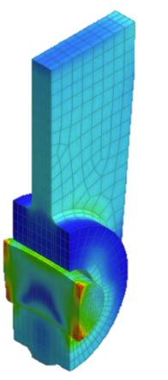
CONTACT ANALYSIS OF ARCH BRIDGE
using MIDAS FEA NX
Rohit Joseph
Technical Support Engineer

Slide 2
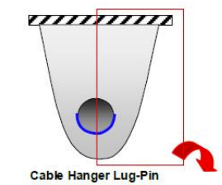
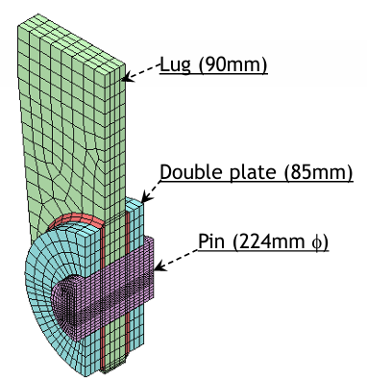

Objective
Understanding contact analysis in FEA NX
Perform nonlinear static contact analysis for the lug and pin connection of an arch bridge using Midas FEA NX.

Slide 3
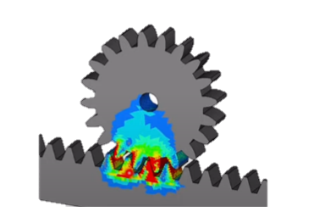
Contents
Introduction: Contact Analysis
Contact analysis in FEA NX
Lug and Pin Connection of Arch Bridge: Demonstration
Result interpretation: Why is Contact Analysis Important?
Real-World Bridge Collapses By to Pin and Lug failures
Q & A Session

Slide 4
Introduction: Contact Analysis
What is contact analysis?
Simulation technique used to model and study the interaction between two or more bodies that come into physical contact during loading. It helps predict how these bodies will behave—how they deform, transfer forces, and possibly separate or slide against each other.
Boundary Nonlinear analysis: The boundary stiffness differs before and after contact.
The contact forces can be split into two components: Normal and tangential
Types of contacts:
  Bonded (welded) contact type
  Frictionless contact type
  Frictional contact type
Ft
Fn

Slide 5
Contact analysis in FEA NX
Why Midas FEA NX?
Midas FEA NX combines powerful nonlinear solvers, a wide range of contact options, and civil engineering–focused features, making it especially suited for analyzing contact behavior in real-world bridge applications like arch structures, segmental joints, and bearing assemblies.
It also supports automatic contact detection, saving time on complex geometries.
Contact Type | Normal Direction | Tangential Direction | Analysis Type
Weld | Bonded | Bonded | Linear / Nonlinear
Bi-directional Sliding Contact | Bonded | Sliding | Linear / Nonlinear
Rough | Separation | No Sliding | Nonlinear only
General | Separation | Sliding (specify friction coefficient) | Nonlinear only
Breaking-Weld | Separation (specify failure force) | Separation (specify failure force) | Nonlinear only
Types of contacts
Welded
Bi-directional sliding contact
General
Rough
Breaking weld

Slide 6
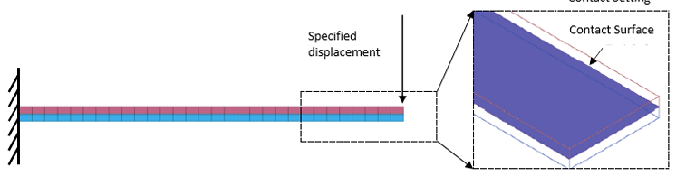
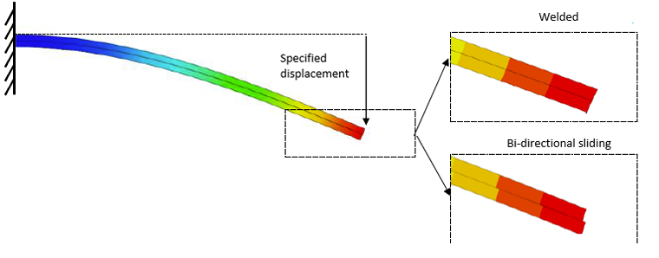
Contact analysis in FEA NX
Types of contacts
Model set up
Welded Contact
Bi-directional sliding

Slide 7
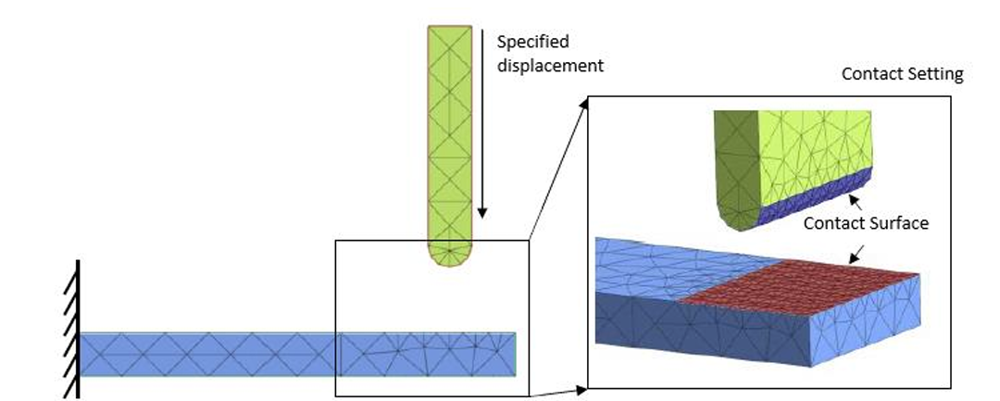
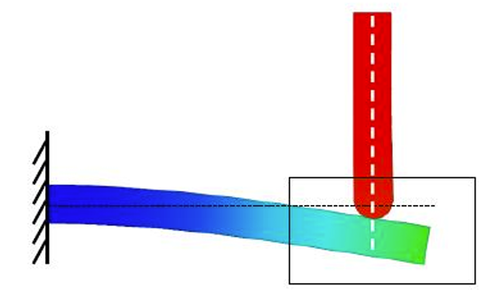
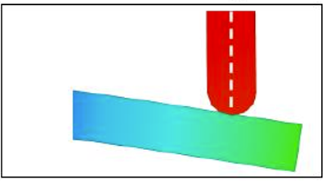
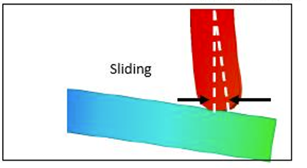
Contact analysis in FEA NX
Types of contacts
Model set up
Rough Contact
(no sliding after contact)
General Contact
(sliding allowed after contact)

Slide 8
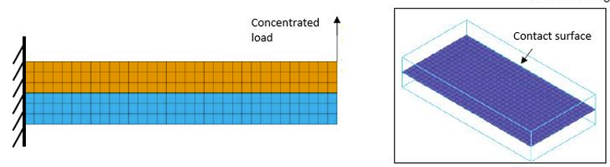
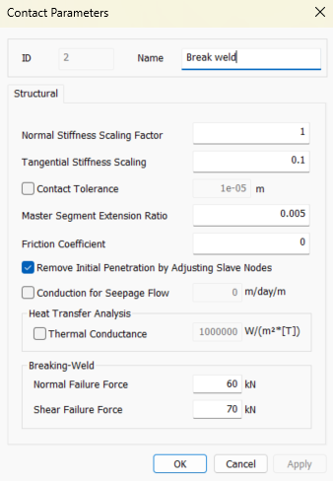
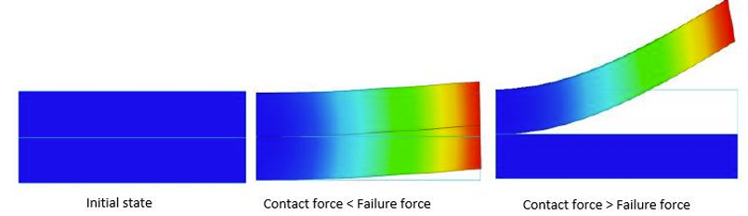
Contact analysis in FEA NX
Types of contacts
Model set up
Break Weld contact

Slide 9
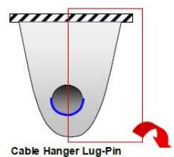
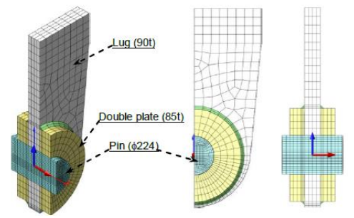
Lug and Pin Connection of Arch Bridge: Demo
This demo presents a nonlinear static contact analysis of a lug and pin connection in an arch bridge using the ‘General’ contact type. Key results like deformations, von Mises stresses, and contact forces are reviewed to highlight the role of contact behavior.
Model set up
Boundary conditions and loading
Interface modelling
Result interpretation

Slide 10
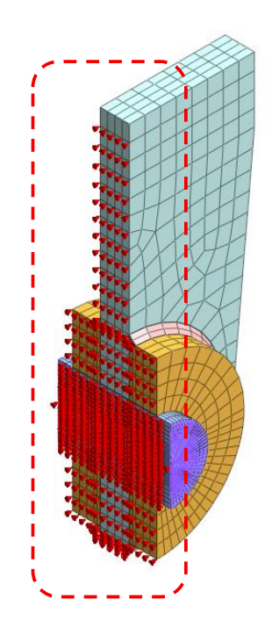
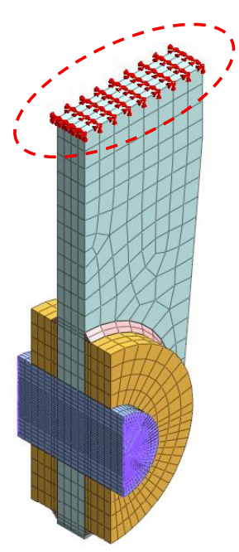
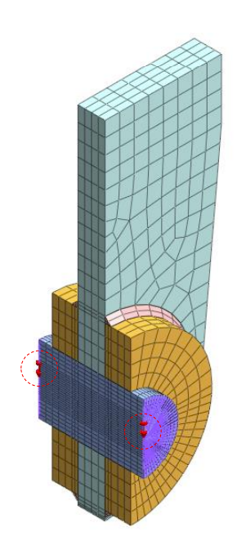

Lug and Pin Connection of Arch Bridge: Demo
Loading: Specified displacement of 0.8 m applied in the gravity direction in the shaft
Constrained in global Y
Constrained in global X Y and Z (pin support)

Slide 11
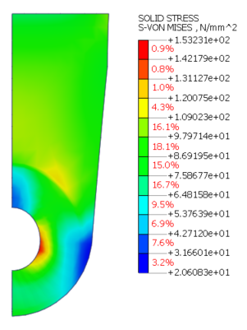
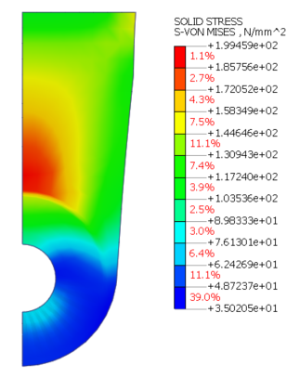
Lug and Pin Connection of Arch Bridge: Demo
It was observed that the shaft yielded at the later stage when the contact was defined. The deformations and the yield in the shaft were comparable. The stresses in the lug without contact is higher compared to the one with, and this can be deceiving and we might think we are overestimating the stresses, hence safe.
Von-mises stresses = 153.23 MPa
(With contact)
Von-mises stresses = 199.5 MPa
(Without contact)
% Difference = 30 %
Von-mises stresses
(With contact)
Von-mises stresses
(Without contact)

Slide 12
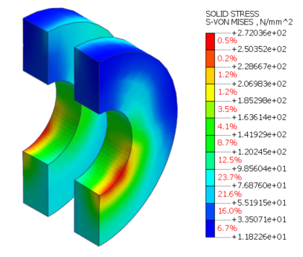
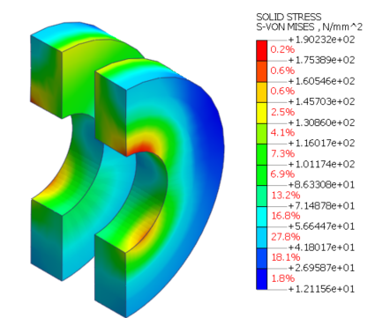
Lug and Pin Connection of Arch Bridge: Demo
In this case, when contact is considered, stress concentrations can be observed at the bottom of the shaft hole in the base plates due to the smaller contact area—unlike the case where contact is not defined and the shaft is fully bonded to the lug and the base plates.
Von-mises stresses = 272 MPa
(With contact)
Von-mises stresses = 190.23 MPa
(Without contact)
% Difference = 30 %
Von-mises stresses
(With contact)
Von-mises stresses
(Without contact)
Thus, underestimating the stresses in the base plates can lead to underdesign, increasing the risk of connection failure and potential collapse.

Slide 13
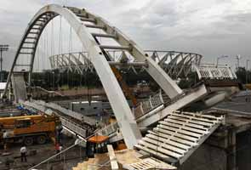
Real-World Bridge Collapses Due to
Pin and Lug failures
Ashtabula River Railroad Bridge (Ohio, USA, 1876)
Silver Bridge (Point Pleasant, WV–Gallipolis, OH, USA, 1967)
Mianus River Bridge (Greenwich, CT, USA, 1983)
Delhi Footbridge (New Delhi, India, 2010)
Key takeaways
Delhi bow-string arch pedestrian bridge failure (2010)
Pin‐lug connections are critical, fatigue-sensitive, and susceptible to corrosion
Failure of a single lug or pin often triggers catastrophic, non-redundant collapse.
Stress concentrators (holes and lugs) demand meticulous design and accurate simulation.
Contact analysis is necessary to simulate the accurate connection behavior especially in complex structure.

Slide 14

THANK YOU
We do the right things right

